Slide 1
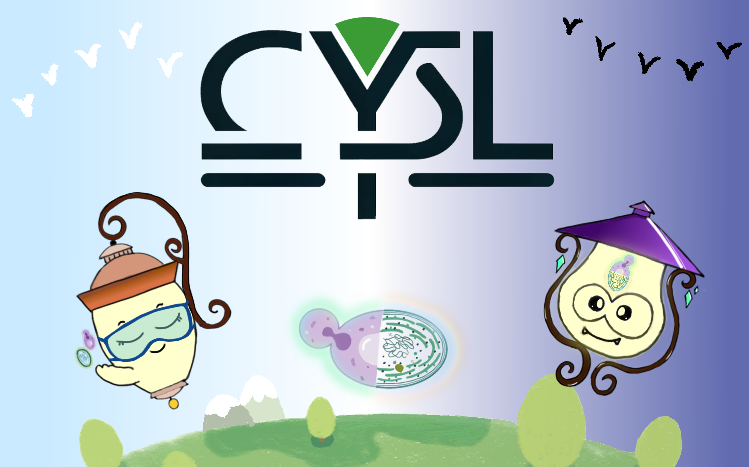

Slide 2



1
Background
2
Design & Wet Lab
Content
3
Dry Lab

Slide 3
4
Human Practice
5
Safety
Content
6
Wiki
7
Trouble Shooting

Slide 4

Background
Street light counts for a lot in our daily life
"And God said, 'Let there be light,' and there was light." ---- Genesis: Chapter 1
Street light. By Pexels

Slide 5

Background
However, light is not so available to many people in their region
What the Earth looks like at night on 2022 February 13. By NASA

Slide 6
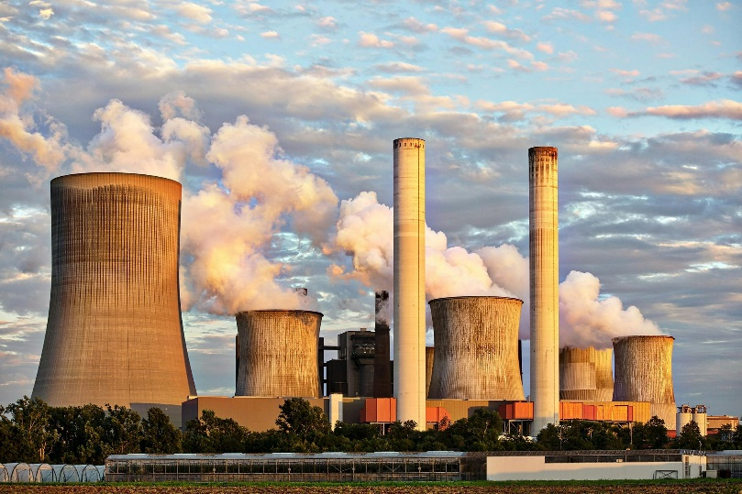
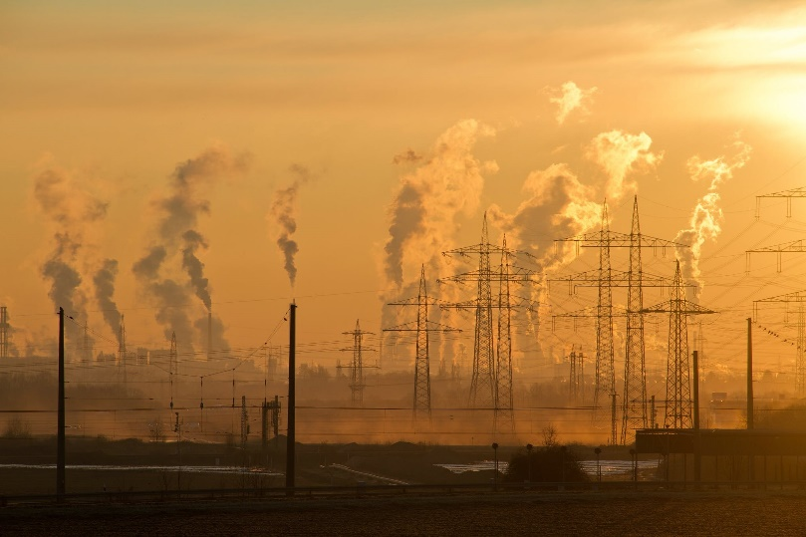
Background
Demand for lighting results in massive electricity consumption and CO2 emissions.
Outdoor lighting accounts for 15-19% of the world's total electricity usage, and it consumes approximately 2.4% of humanity's annual energy resources. Additionally, it contributes to 5-6% of global greenhouse gas emissions.
Data from Statistical Review of World Energy, 2020 68th edition
Power plants. By Pexels

Slide 7
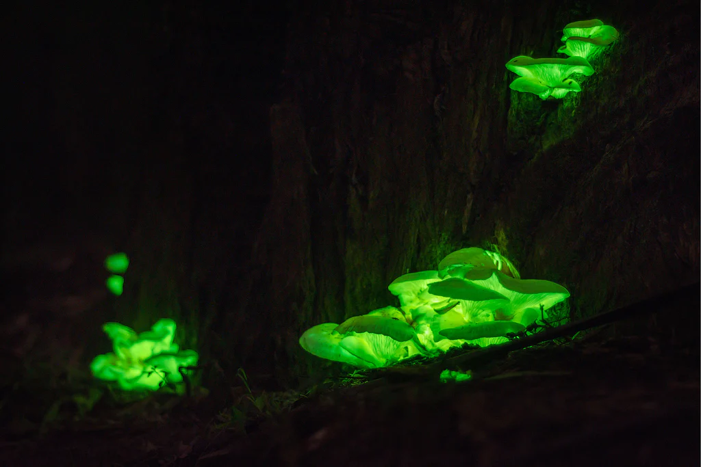
Background
Light is never the prerogative of human
Many living creatures have been observed to own the ability to give out light like Fire fly, Cypridina, Neonothopanus nambi etc.
Neonothopanus nambi. By VELAB.

Slide 8

Background
What if?
We may build a wireless system based on the natural bio-luminescence system to substitute street light, using bio-switch to control light emission. Synthetic biology also give a chance to make this system carbon neutral or even carbon absorption!
Created by ChatGPT

Slide 9



Design: Principle
Environmentally friendly
Our project should be sustainable and reliable, hopeful to help create better environment, performing better in carbon accounting.
Efficient
To make it really come into our life, our project should reveal good efficiency compared with traditional street lighting. It should be at least as functional as the traditional light. Able to automatically switch the light and the light intensity should meet the needs of resident.
Profitable
Cost is a pivotal factor in bio-engineering. Only when the project is profitable can it attracts more companies to invest in it. Street lighting is rooted everywhere in everybody's life, so there is a giant market for better street lighting strategies. Our project should possess commercial potential to go further.

Slide 10
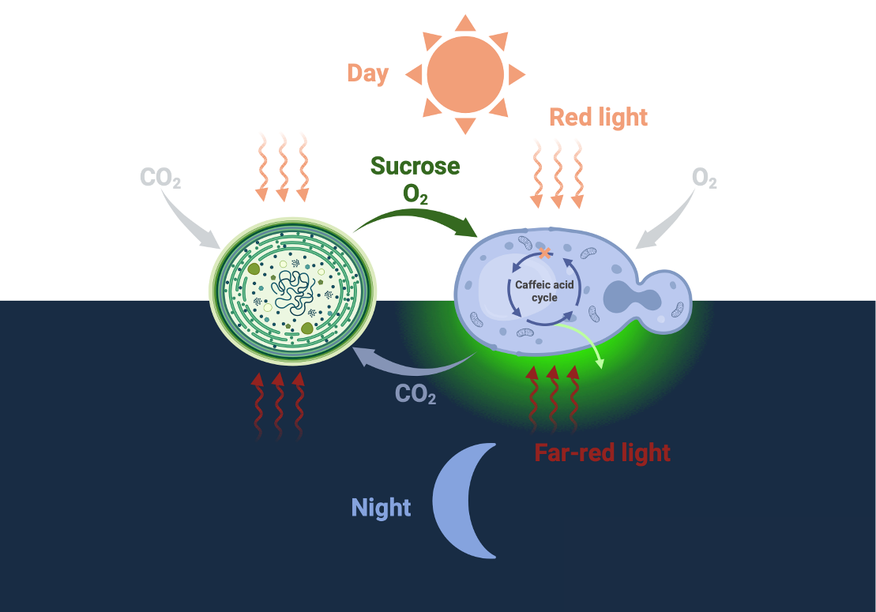
Design: Overview
CYSL: Cyanophyta-Yeast Co-culture System for Carbon Neutral Street Lighting
Our project was designed to achieve:
1. Carbon neutral
Co-culture system utilized the carbon absorption capacity of cyanophyta.
2. Emission light
The caffeic acid cycle was introduce as light source.
3. Automatically recognize day and night
GBD-PhyA-FHY1-TUP1 system as a bio-switch that sense the light.
Created by BioRendor

Slide 11
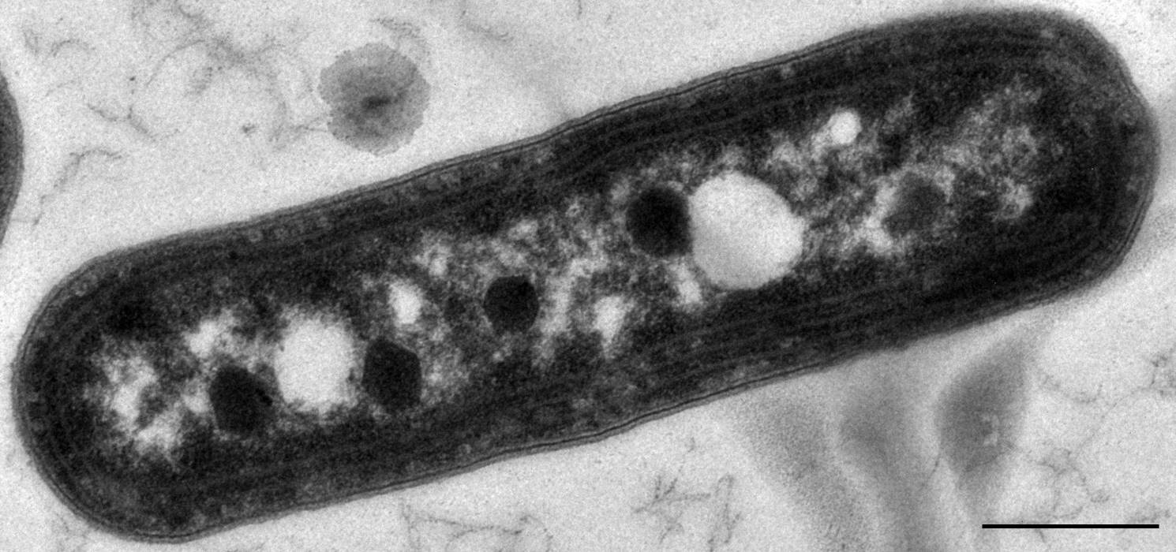
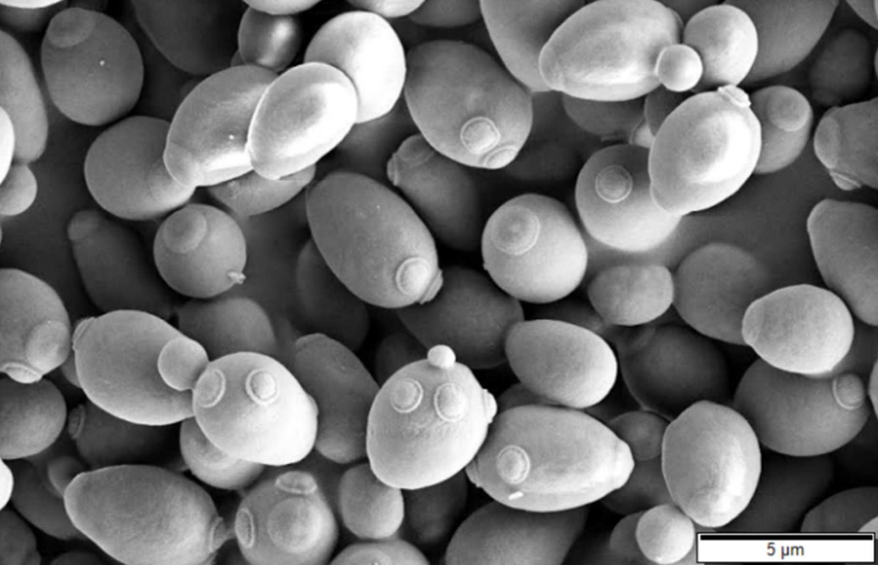
Design: Co-culture System
Cyanophyta for $CO_{2}$ utilization and yeast for light production
Up to 50% of the overall operating cost: carbon source [6,12].
The choice of sugar feedstock therefore remains a challenge to achieve a sustainable and cost-effective bioproduction [4,6].
Electron micrograph of S. elongatus PCC 7942. From wikipedia.
Scanning electron micrograph of S. cerevisiae. From wikipedia.
Photoautotrophic organisms
Release sucrose under salt stress
Engineering is more difficult
Easier for engineering and culturing
Available data from predecessors
Better for loading fungal bio-luminescence pathway

Slide 12
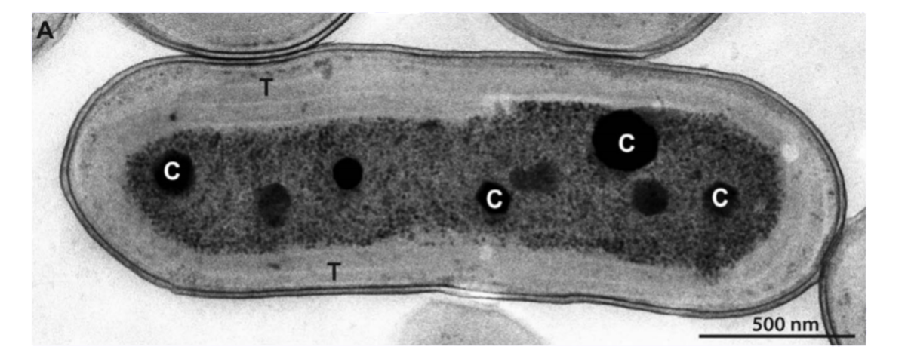
Design: Co-culture System
S. elongatus UTEX 2973, an attractive chassis for sustainable bioproduction
S. elongatus UTEX 2973 (hereafter Syn UTEX 2973), a freshwater cyanobacterium strain isolated in 2015, grows photo-autotrophically with one of the fastest rates reported for any photosynthetic microbe, with generation times as low as 1.5 hours which is equivalent to heterotrophic organisms such as certain yeasts [1, 2].
Electron micrographs of S. elongatus UTEX 2973. Adapted from Yu et al.2015[1]

Slide 13
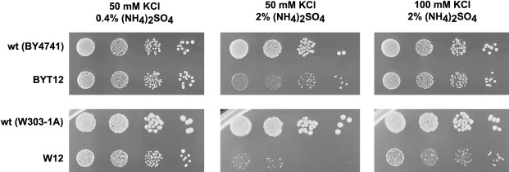
Design: Co-culture System
Saccharomyces cerevisiae W303 clump, a good consumer of sucrose
Based on the work down by Hays et al.[3], we chose S. cerevisiae W303 clump as our strain.
It is notable that W303 performed far better than other strains under salt stress (Figure 2), making it more suitable for our design.
Saccharomyces cerevisiae BY4741 and W303-1A laboratory strains differ in salt tolerance. Adapted from Hana et al.[13]

Slide 14
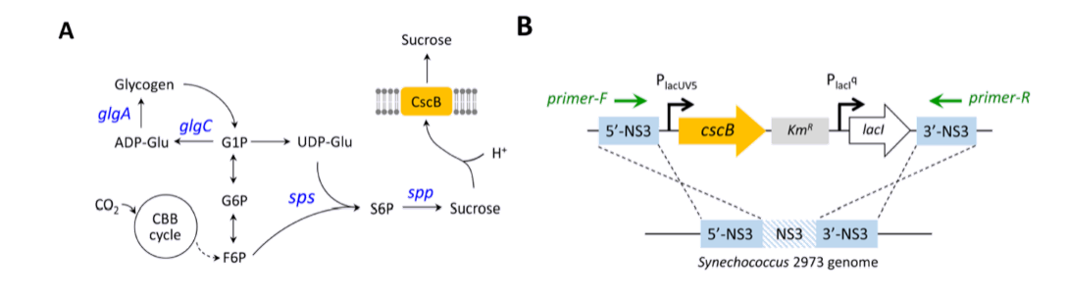
Design: Co-culture System
Strain Saccharomyces cerevisiae W303 clump, a good consumer of sucrose
The recovery of sugars can be performed by a “one pot” synthetic microbial consortium between the sucrose secreting cyanobacteria and another heterotrophic organism [3]. This modular approach has been successfully applied for yeast species [3,4].
Engineering sucrose secretion in Syn UTEX 2973. Adapted from Lin et al.2020 [4]
Engineered UTEX 2973 acheived sucrose production with a rate of 1.9 $g⋅L^{−1}⋅day^{−1}$in salt stress conditions, reaching titers as high as 8 $g⋅L^{−1}$[4].

Slide 15
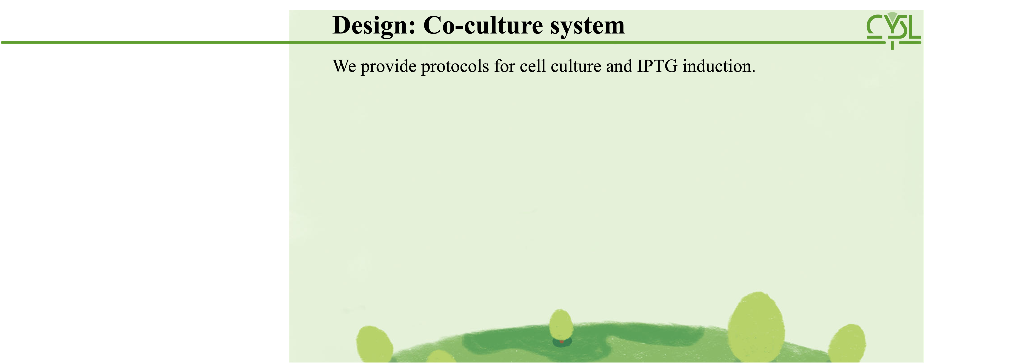
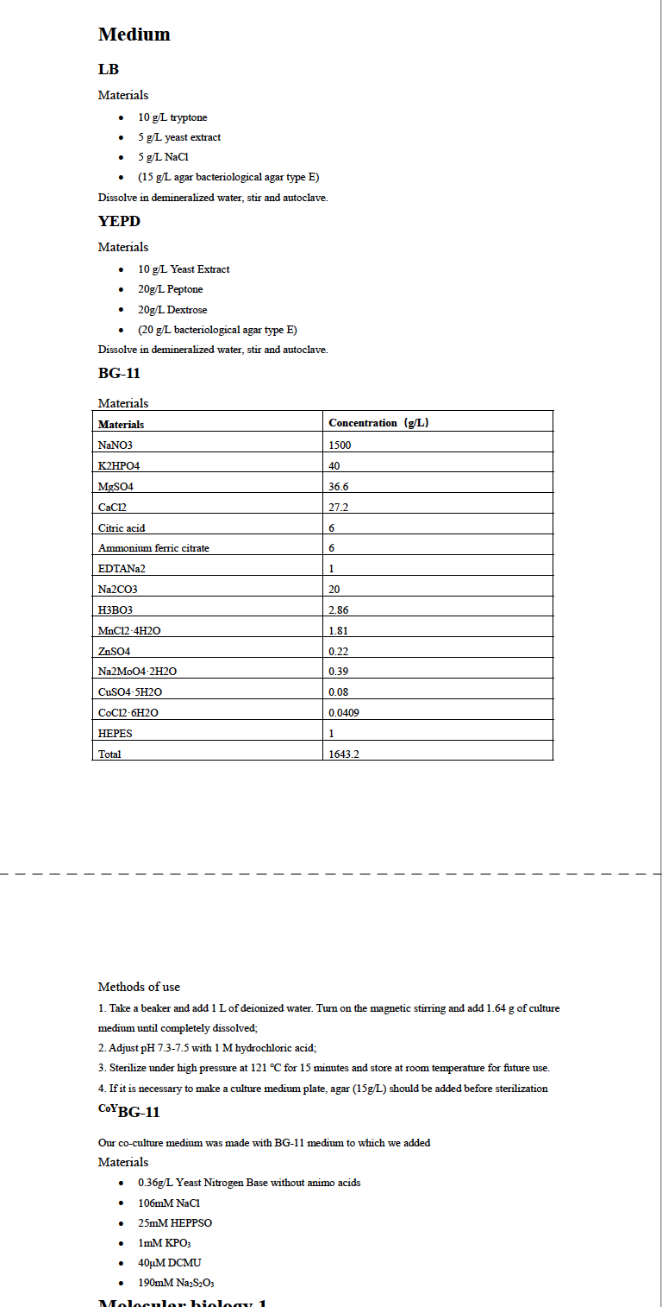
Design: Co-culture system
Design: Co-culture System
We provide protocols for cell culture and IPTG induction.
Learn more on our wiki!

Slide 16
Design: Co-culture system
Design: Co-culture System
We provide protocols for cell culture and IPTG induction.
Learn more on our wiki!

Slide 17
Design: Co-culture system
Design: Co-culture System
We provide protocols for cell culture and IPTG induction.
Learn more on our wiki!

Slide 18
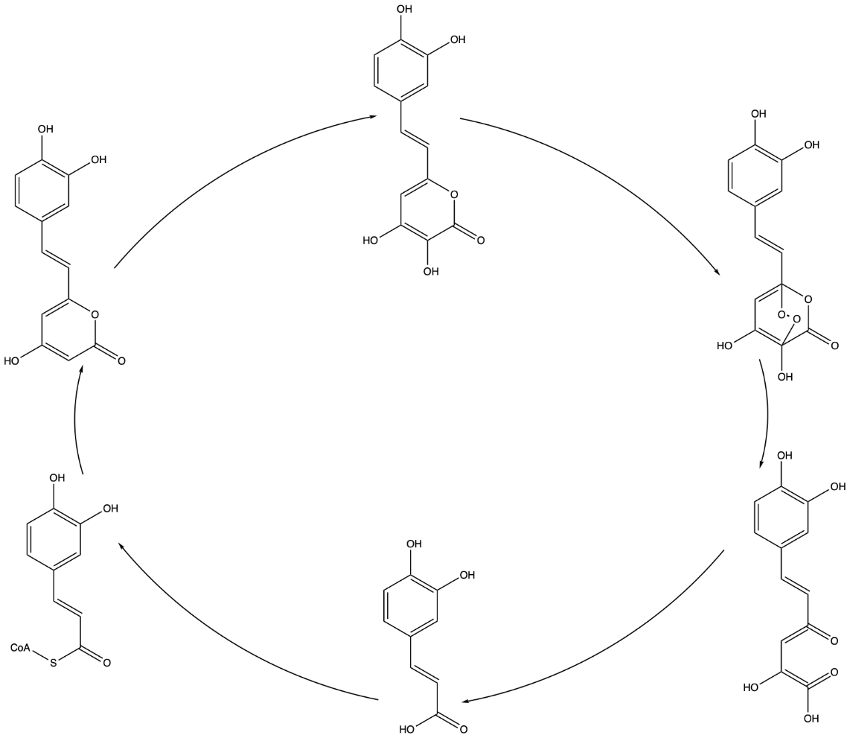
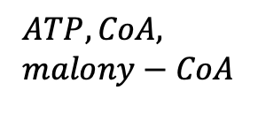
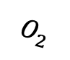
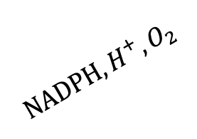
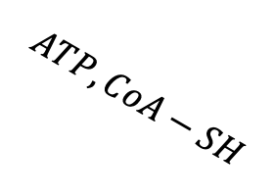
Design: The Bioluminescence System
Fungal bioluminescence pathway.
$$NADPH, H^{+}, O_{2}$$
$$O_{2}$$
Four key enzymes: Luz H3H HispS CPH
Important substrate: caffeic acid
Research shows that fungi which is introduced the four enzymes and caffeic biosynthesis pathway can luminous as well [5]
H3H
Luz
Hispidin
3-hydroxyhispidin
High energy intermediate
$$ATP, CoA, \\ malony−CoA$$
HispS
Light
HispS
CPH
$$ATP, CoA−SH$$
Caffeylpyruvic acid
Caffeolyl CoA
Caffeic acid

Slide 19
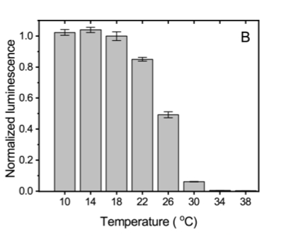
Design: The Bioluminescence System
The heat instability further ensured the day-night-switch.
The Luciferase from fungi is not stable above 30 degrees (Figure 6)[5].
During the day, the Luciferase will become inactive and the circuit will be blocked.
During the night, as the Luciferase began to be produced, the circuit will recover and luminous.
Total light emission after 10min incubation of recombinant purified Luz at various temperatures [5].

Slide 20
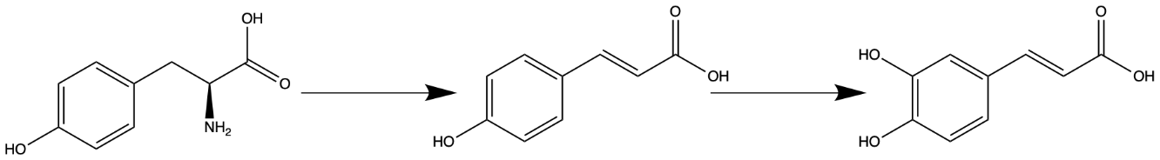
Design: The Bioluminescence System
S.cerevisiae modification
Previous research shows that TAL from Rhodobacter capsulatus (RcTAL) could catalyze the deamination of l-tyrosine and led to the biosynthesis of p-coumaric acid in S. cerevisiae.
C3H from A. thaliana could catalyze the hydroxylation of p-coumaric and led to the biosynthesis of caffeic acid. [6].
As C3H depends on cytochrome P450 reductase (CPR), the CPR is needed to transfer electrons.
TAL
C3H
L-Tyr
p-CA
CA
Caffeic acid biosynthesis pathway. By Chemdraw.

Slide 21
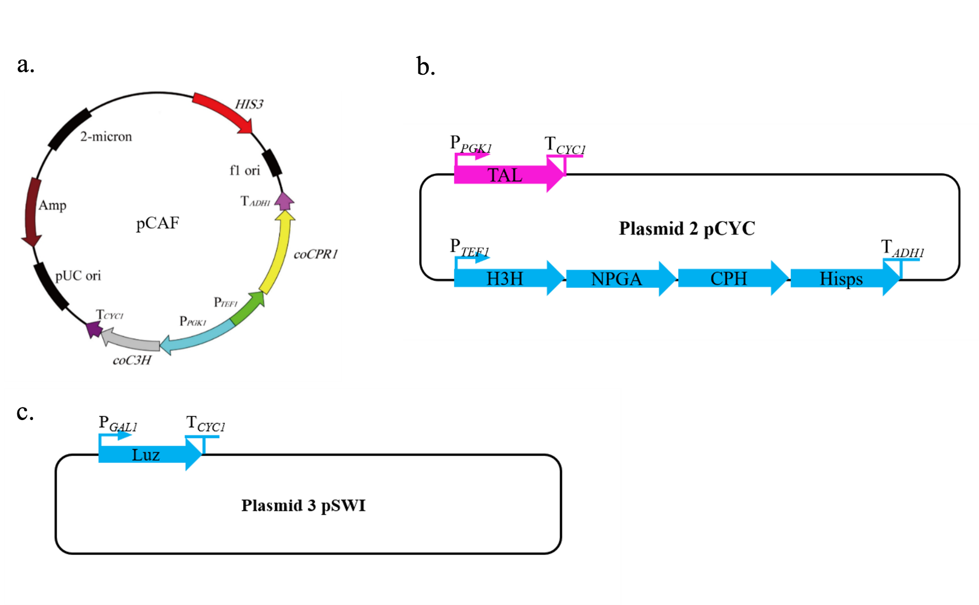
Design: The Bioluminescence System
S.cerevisiae modification
pCAFL: totally same as the one in the original paper.
pCYC: we planned to load 5 genes for enzymes on it by gibbs assembly.
pSWI: loaded with luciferase with GAL1 promoter.
pCYC and pSWI were designed by ourselves
Representation of pCAF [5], pCYC and pSWI.

Slide 22
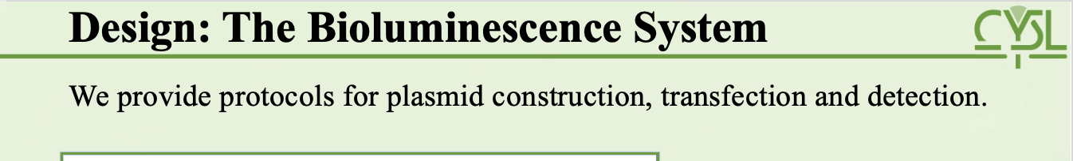
Design: Co-culture system
Design: The Bioluminescence System
We provide protocols for plasmid construction, transfection and detection.
Learn more on our wiki!

Slide 23
Design: Co-culture system
Design: The Bioluminescence System
We provide protocols for plasmid construction, transfection and detection.
Learn more on our wiki!

Slide 24
Design: Co-culture system
Design: The Bioluminescence System
We provide protocols for plasmid construction, transfection and detection.
Learn more on our wiki!

Slide 25
Design: Co-culture system
Design: The Bioluminescence System
We provide protocols for plasmid construction, transfection and detection.
Learn more on our wiki!

Slide 26
Design: Co-culture system
Design: The Bioluminescence System
We provide protocols for plasmid construction, transfection and detection.
Learn more on our wiki!

Slide 27
Design: Co-culture system
Design: The Bioluminescence System
We provide protocols for plasmid construction, transfection and detection.
Learn more on our wiki!

Slide 28
Design: Co-culture system
Design: The Bioluminescence System
We provide protocols for plasmid construction, transfection and detection.
Learn more on our wiki!

Slide 29
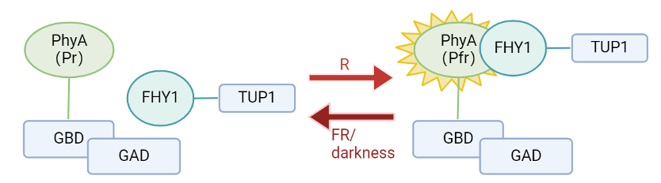
Design: A Light-controlled Gene Switch
Light-controlled Phy-FHY1
Phytochromes (Phys) are plant photoreceptors that exist in two inter-convertible conformational states.
Pr is the inactive form and cannot interact with FHY1 and Pfr is the active form.
When absorbing far red light or being kept in darkness,Pfr(active) will turn into Pr(inactive).
Representation of how Phy-FHY1 react with light.

Slide 30
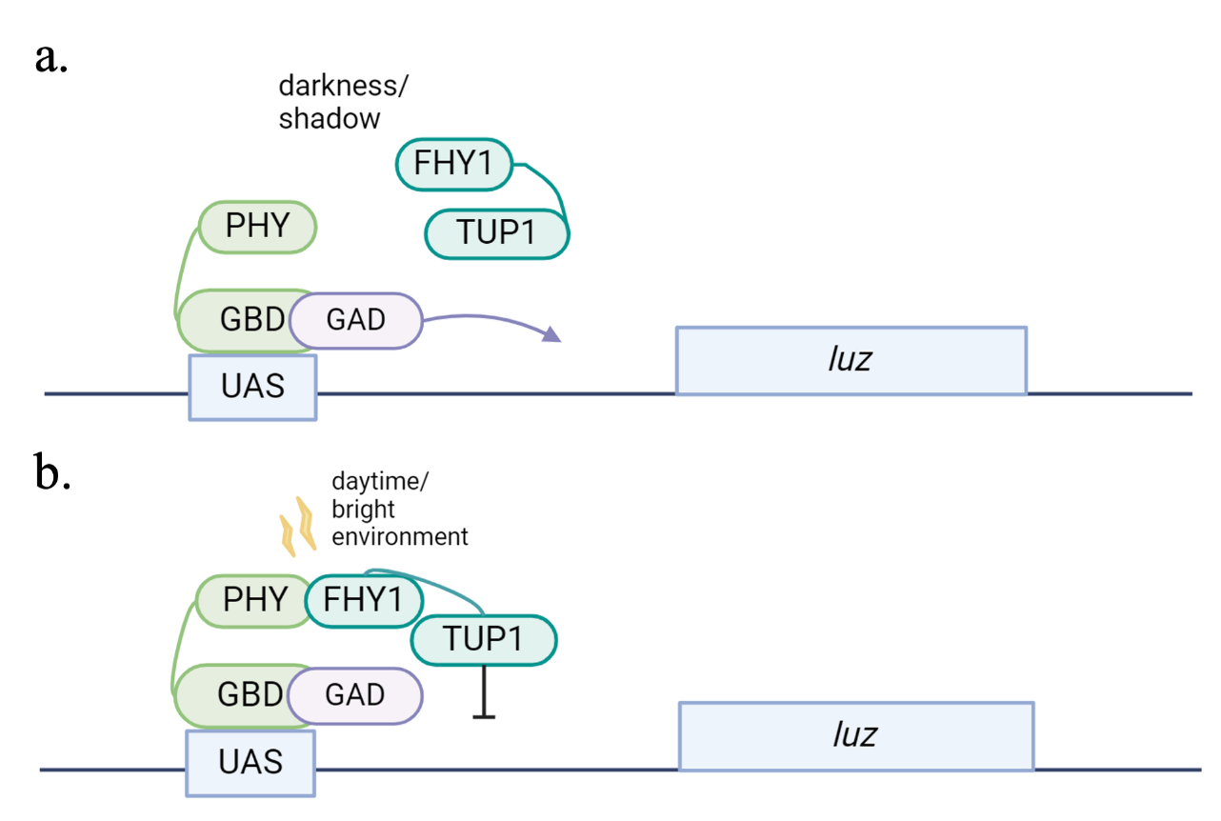
Design: A Light-controlled Gene Switch
Repressor TUP1
TUP1 is a yeast general repressor protein.
The N-terminal 200 residues of TUP1 are sufficient to cause repression when artificially recruited to a promoter [7].
TUP1 can repress gene expression even when GAD exists [8].
Representation of how Phy-FHY1 acts as a gene switch.

Slide 31
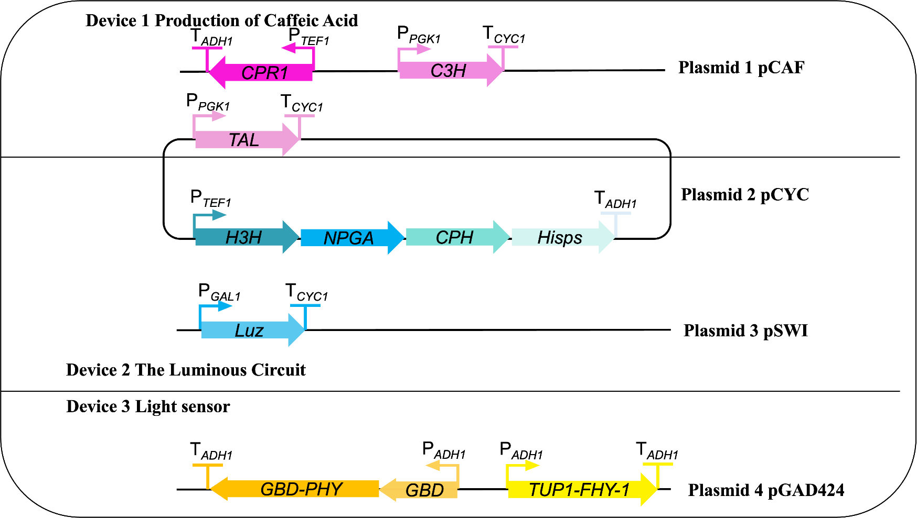
Design: A Light-controlled Gene Switch
Also, we designed a part to achieve our goal.
It should notable that it seems that we have put too much pressure on yeast,.
Maybe we can utilize the co-culture system, letting cyano share some burden.
Representation of all the parts we built for our system

Slide 32

Dry Lab: Fusion Protein
AlphaFold2 is an artificial intelligence software developed by DeepMind to predict the 3D structure of proteins.
AlphaFold2 predicts with high enough accuracy to approximate experimental measurements.In our experiments, we used AlphaFold2 colab to design a fusion protein we needed.
Home page of alphafold.

Slide 33
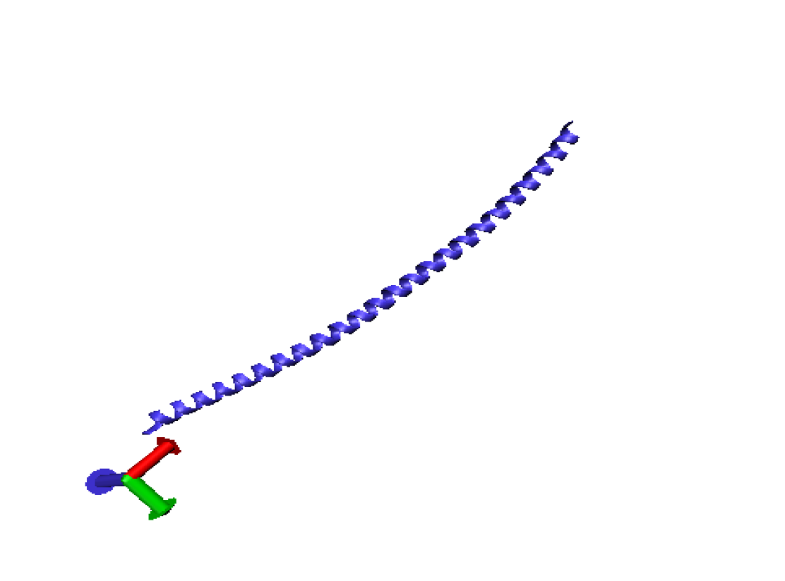
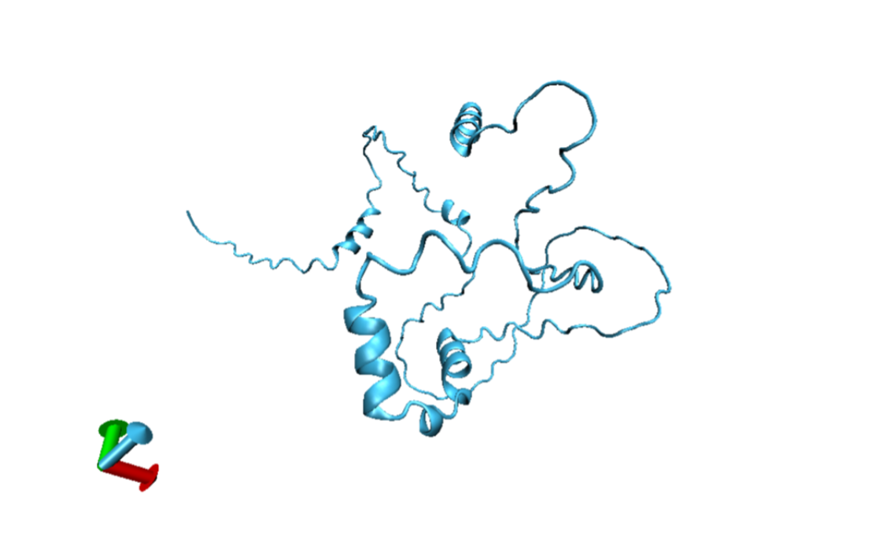
Dry Lab: Fusion Protein
TUP1
FHY1
3D structure of TUP1. By VMD.
3D structure of FHY1. By VMD.
These two proteins should function themselves respectively. Protein TUP1 needs its N-terminal sequences to function normally

Slide 34
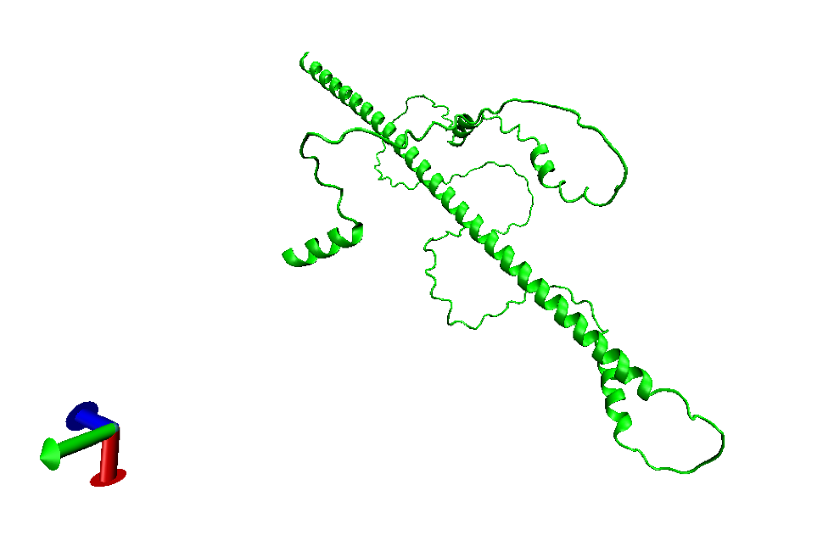
Dry Lab: Fusion Protein
When we simply put the sequences together, we found that TUP1 positioned through FHY1. And that wasn’t what we need as we proposed that mixing structure of two proteins will cause functional loss. So we decided to choose a proper linker to link two proteins as well as separate them into two clear part in space.
Predicted 3D structure of FHY1-TUP1. By VMD.

Slide 35
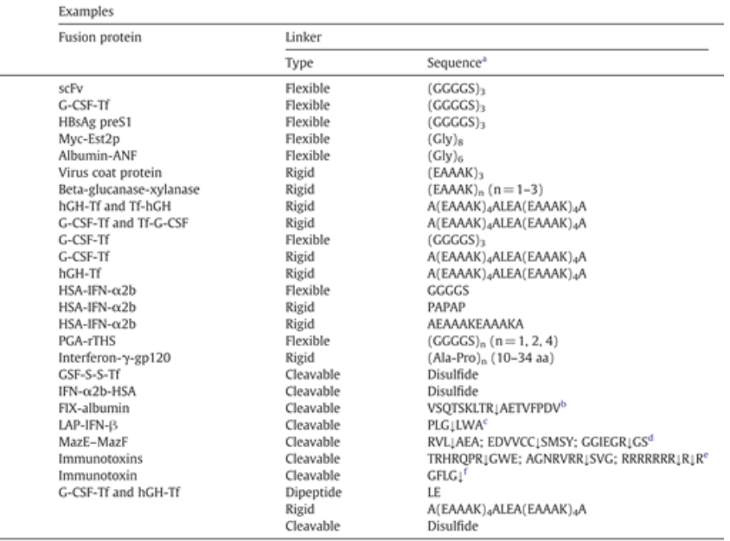
Dry Lab: Fusion Protein
We used some linkers that were often used in design of a fusion protein.
We proposed that flexible linker wouldn’ t help us divide the proteins into two clear part.
So we choose rigid linkers primarily, such as (EAAAK)n, PAPAP, A(EAAAK)₄ALEA(EAAAK)₄ A

Slide 36
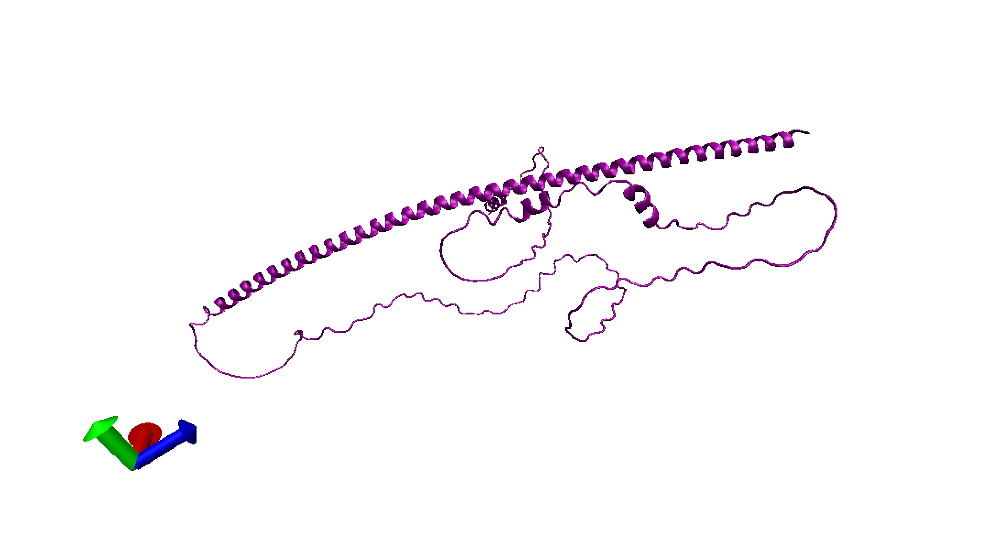
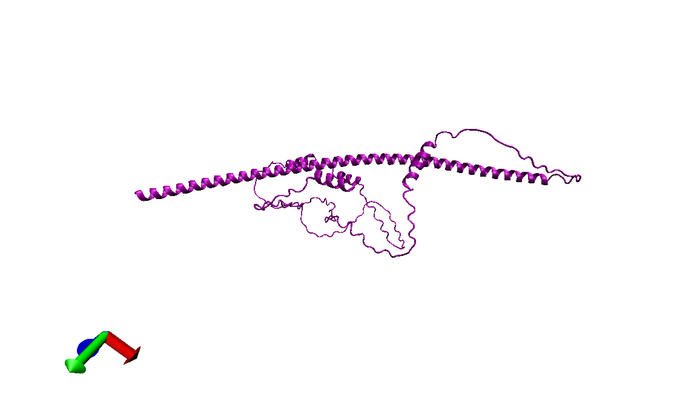
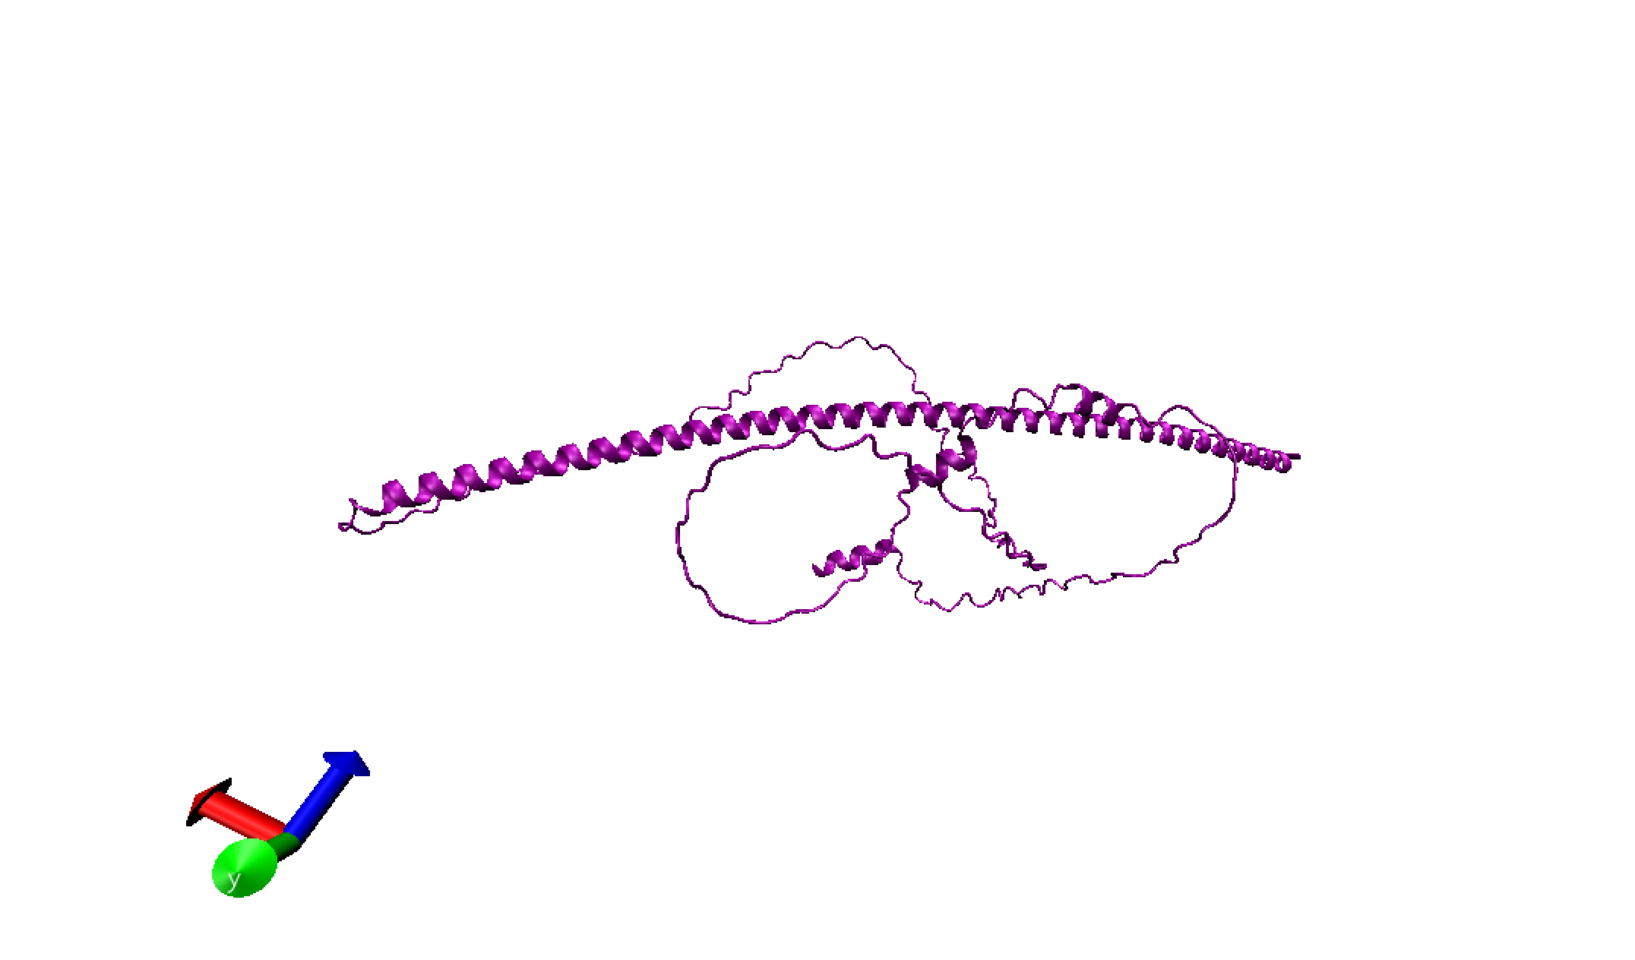
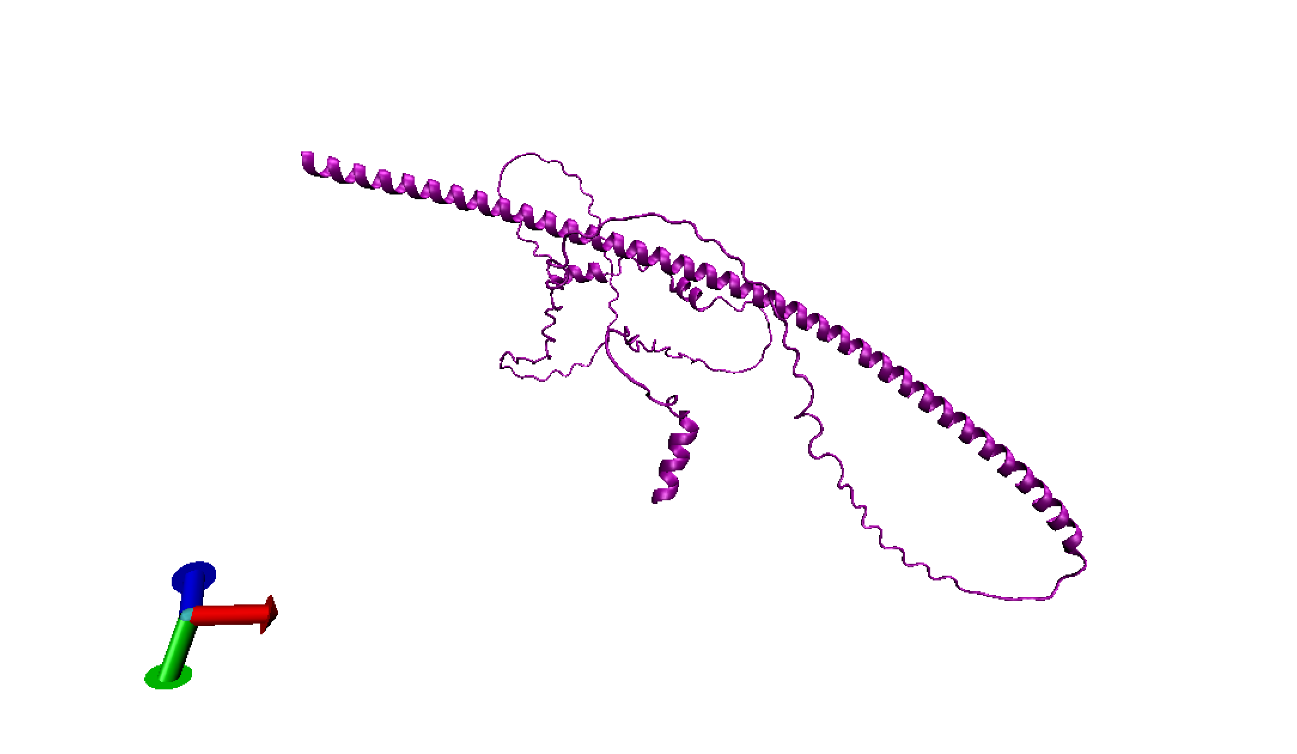
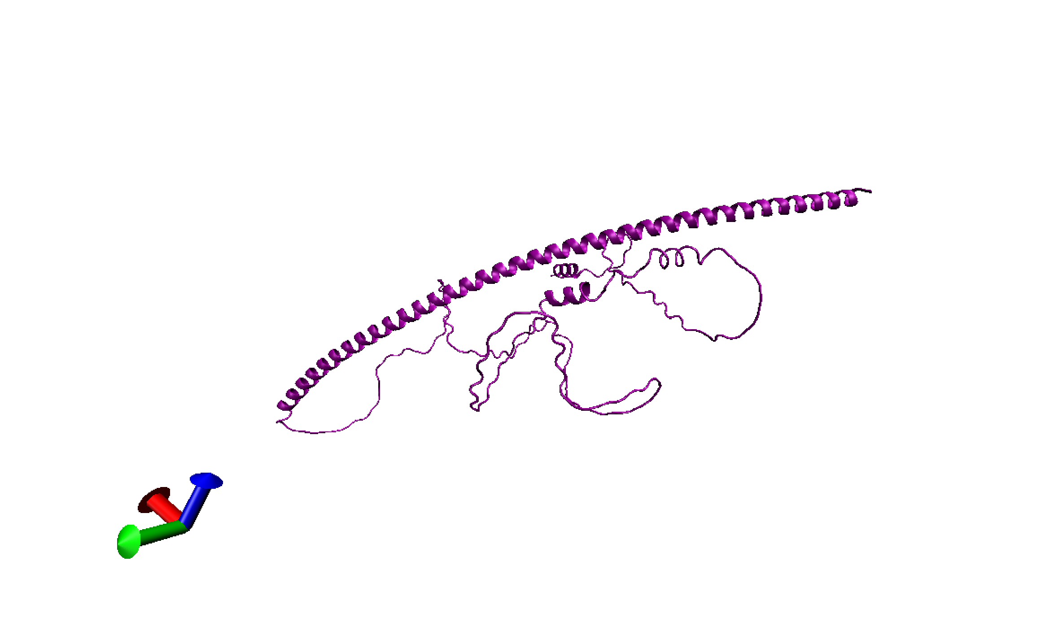
Dry Lab: Fusion Protein
Predicted 3D structure of FHY1-TUP1（test10). By VMD.
We designed 12 different linkers and expect to find a best one.
Fortunately, one of our design showed almost complete separation of 5 models AlphaFold2 had displayed .
It must be noticed that the pLDDT number of our model were around 59, with our best predicted design had the higher number of 62. We proposed that the flexibility of FHY1 caused the lower number of pLDDT.

Slide 37
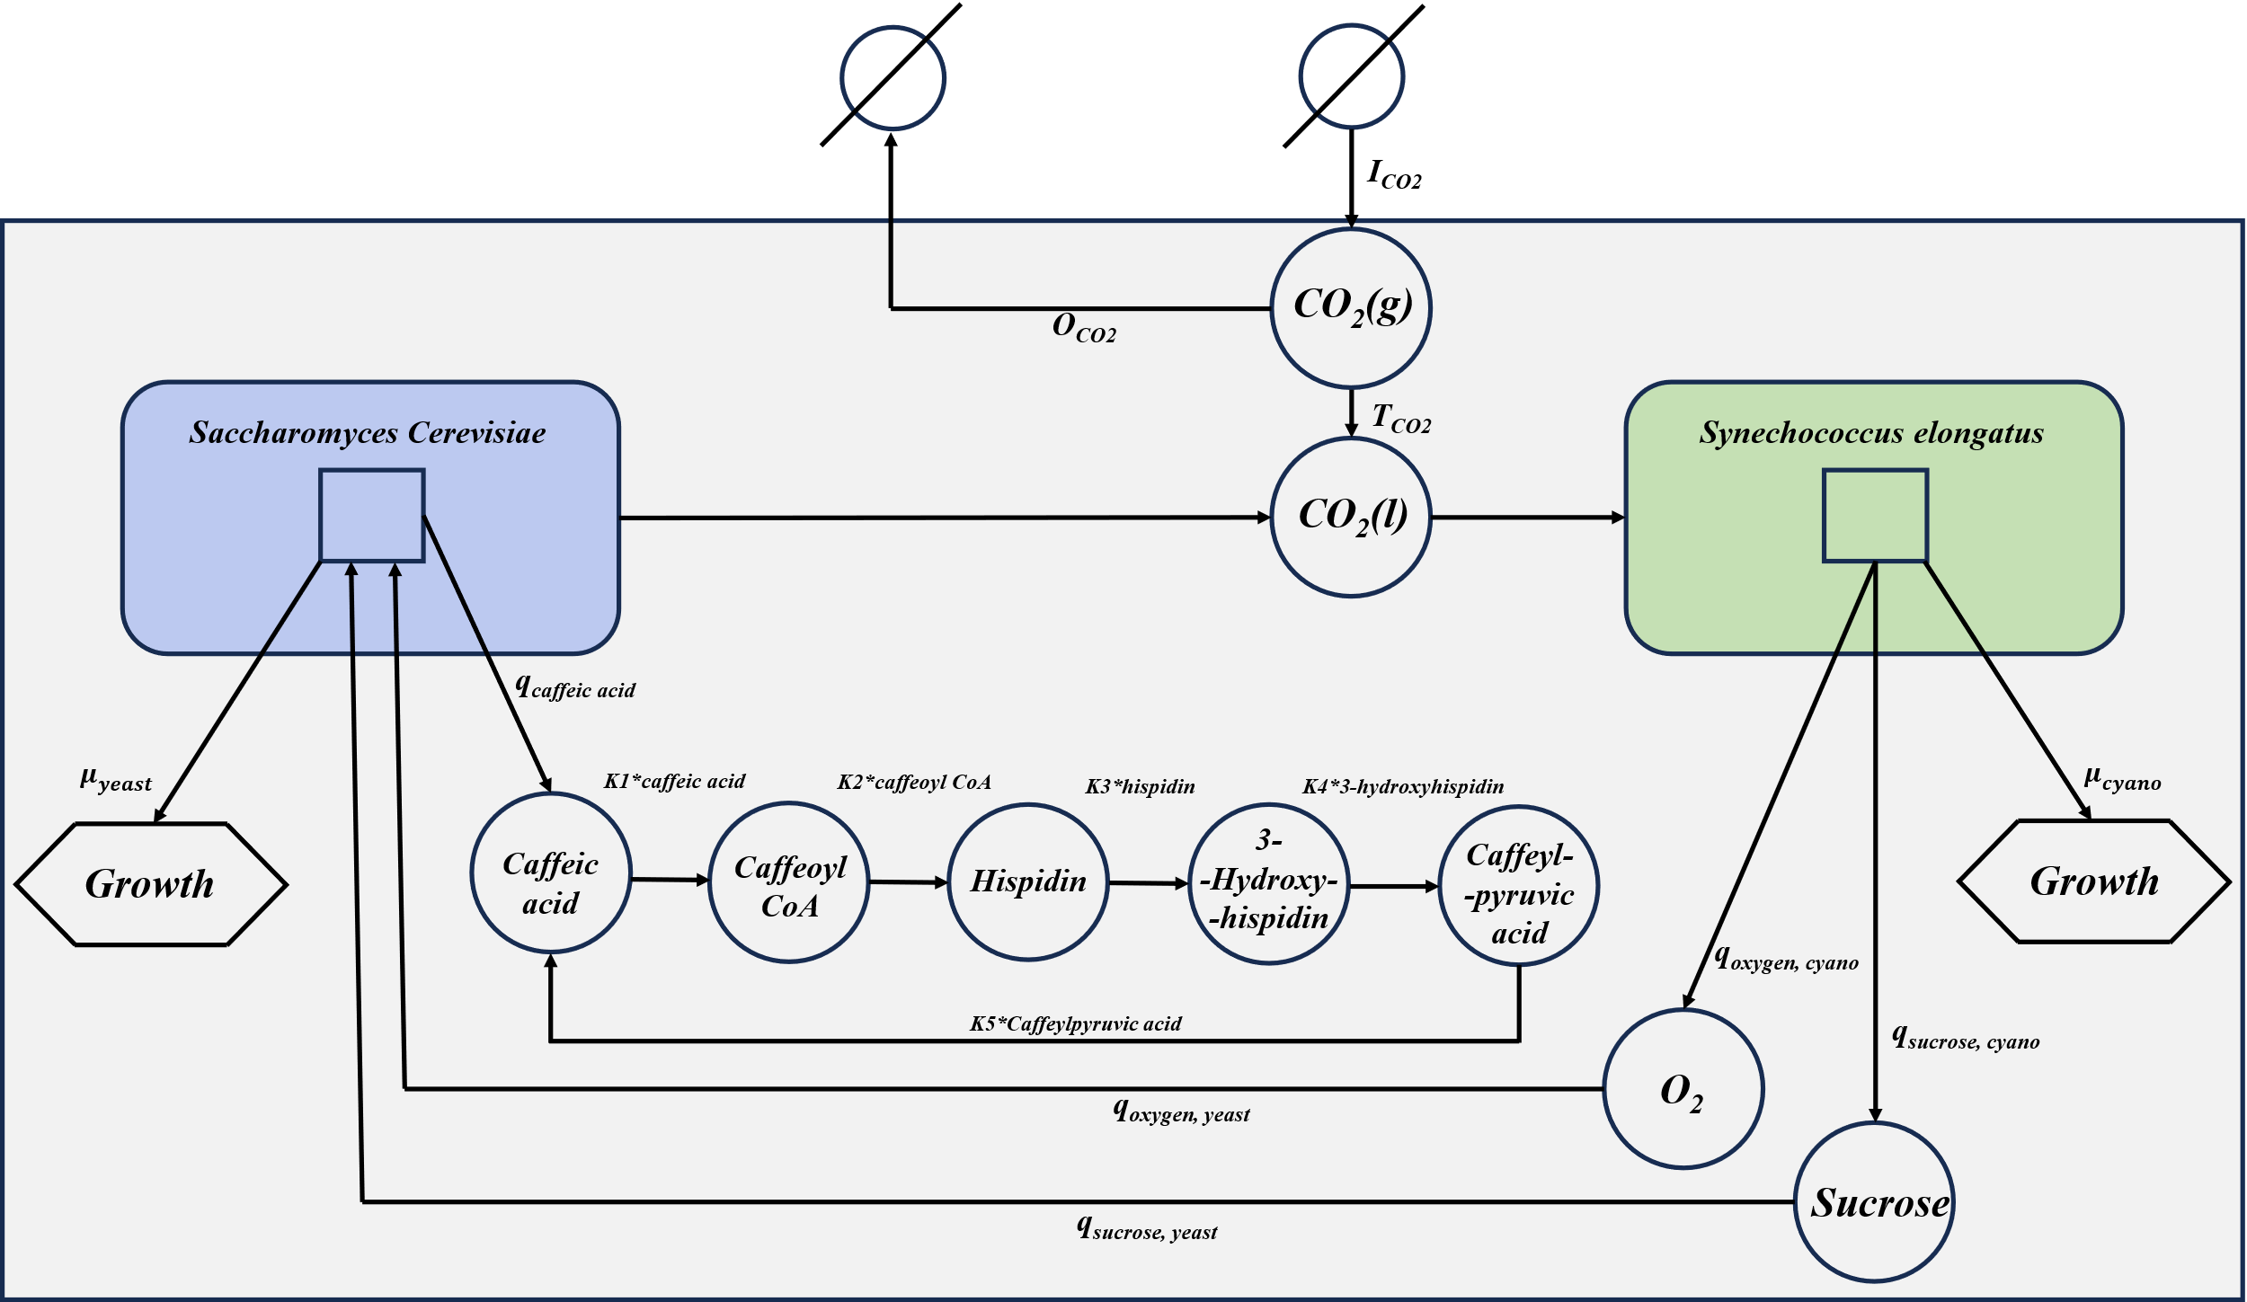
Dry Lab: A Dynamic Coculture Model
ODEs GSMs
The final model representing a broad range of processes.(growth of each microorganism, metabolite production and utilization etc).
This model can be written by SBML and realized by cobra in python.
Our model are based on the model developed by Toulouse INSA-UPS.
Representation of our model.

Slide 38

Dry Lab: A Dynamic Coculture Model
Construction of the system of ODEs
growth, CO₂ gas transfer, Carbon source uptake, Light, Caffeic acid cycle

Slide 39
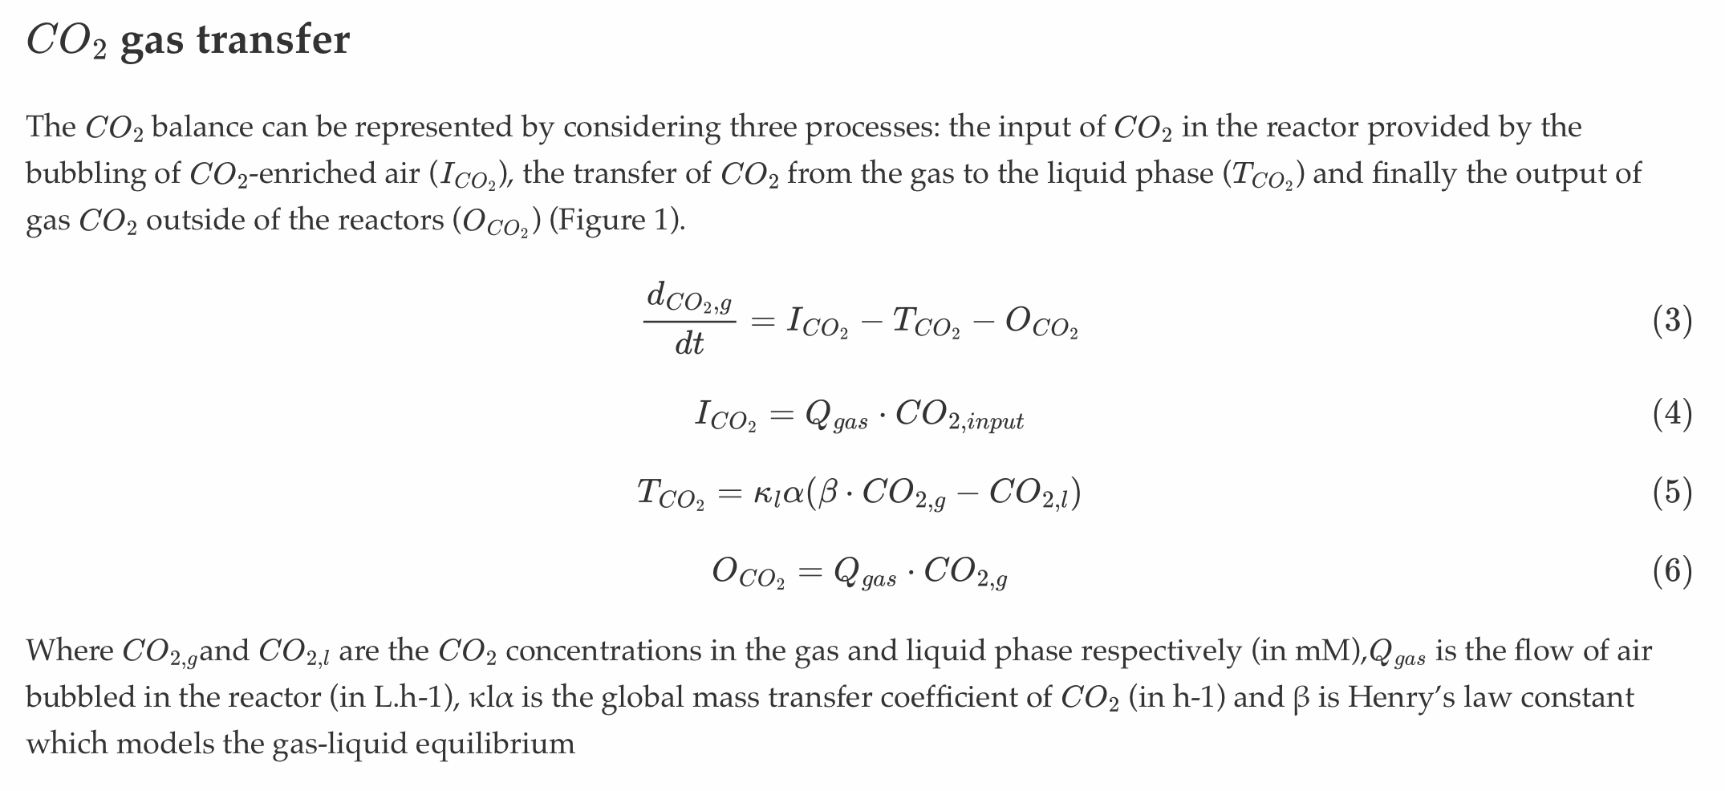
Dry Lab: A Dynamic Coculture Model

Slide 40
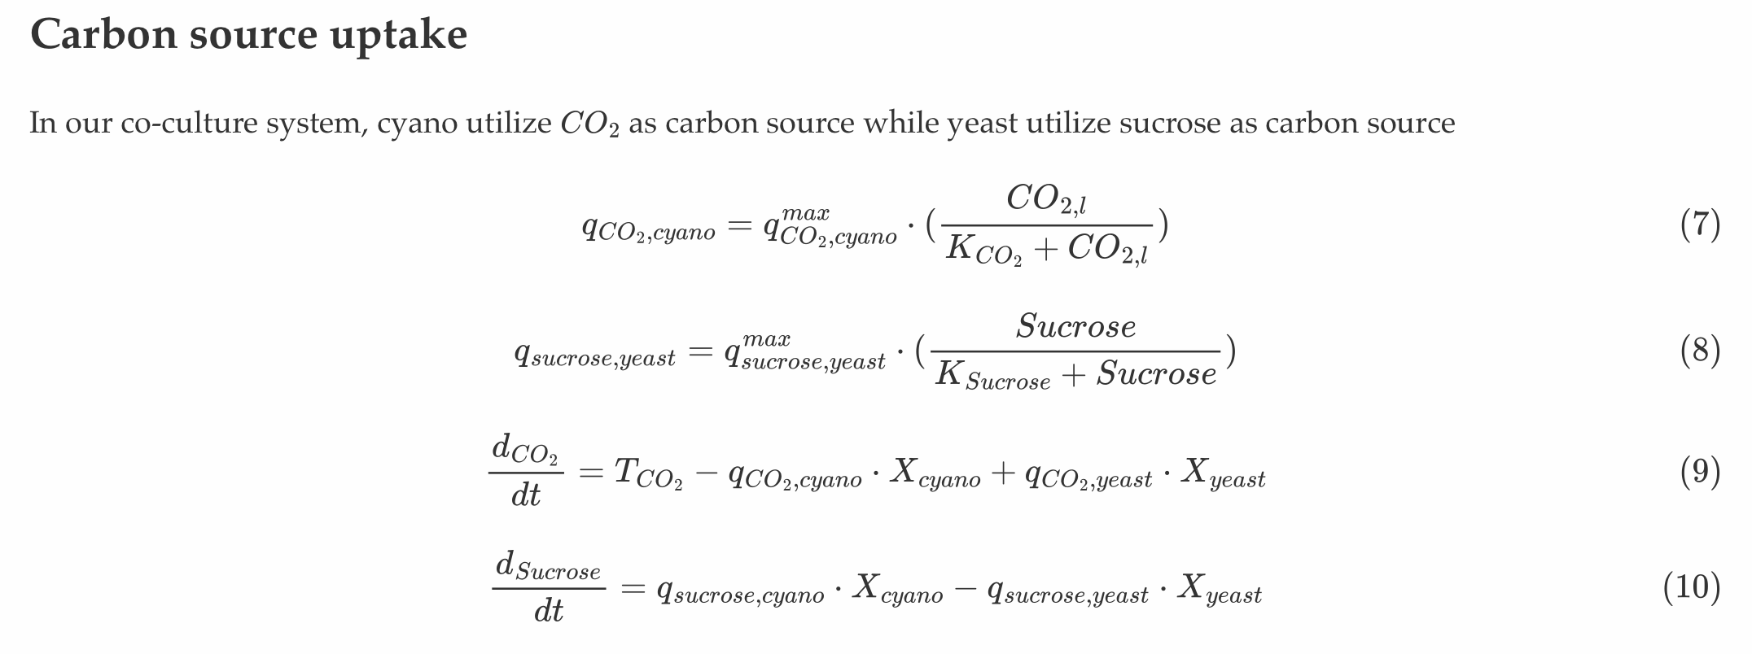
Dry Lab: A Dynamic Coculture Model

Slide 41
Dry Lab: A Dynamic Coculture Model

Slide 42
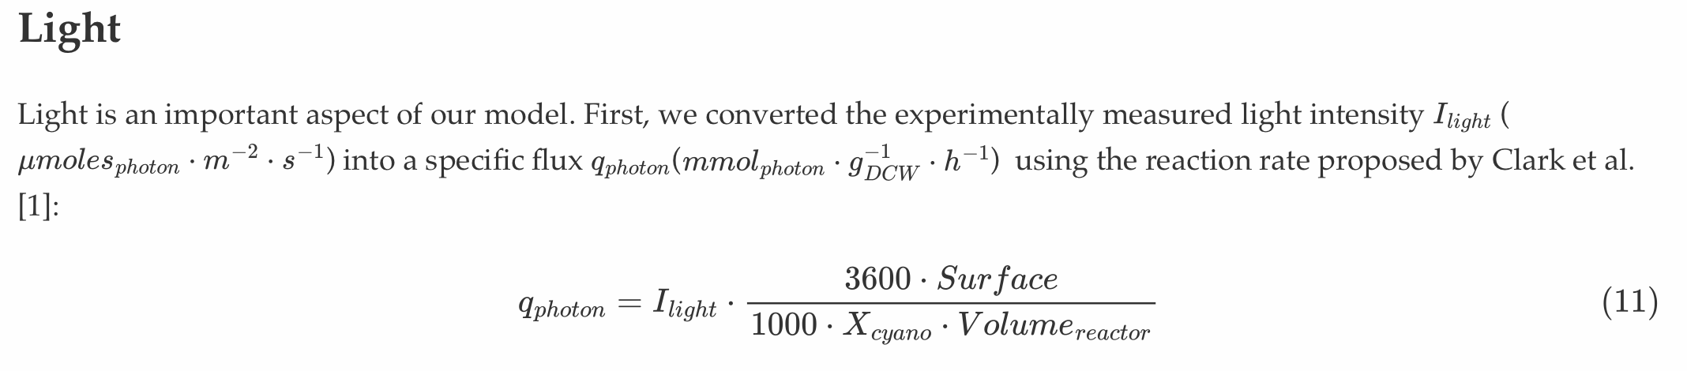
Dry Lab: A Dynamic Coculture Model

Slide 43
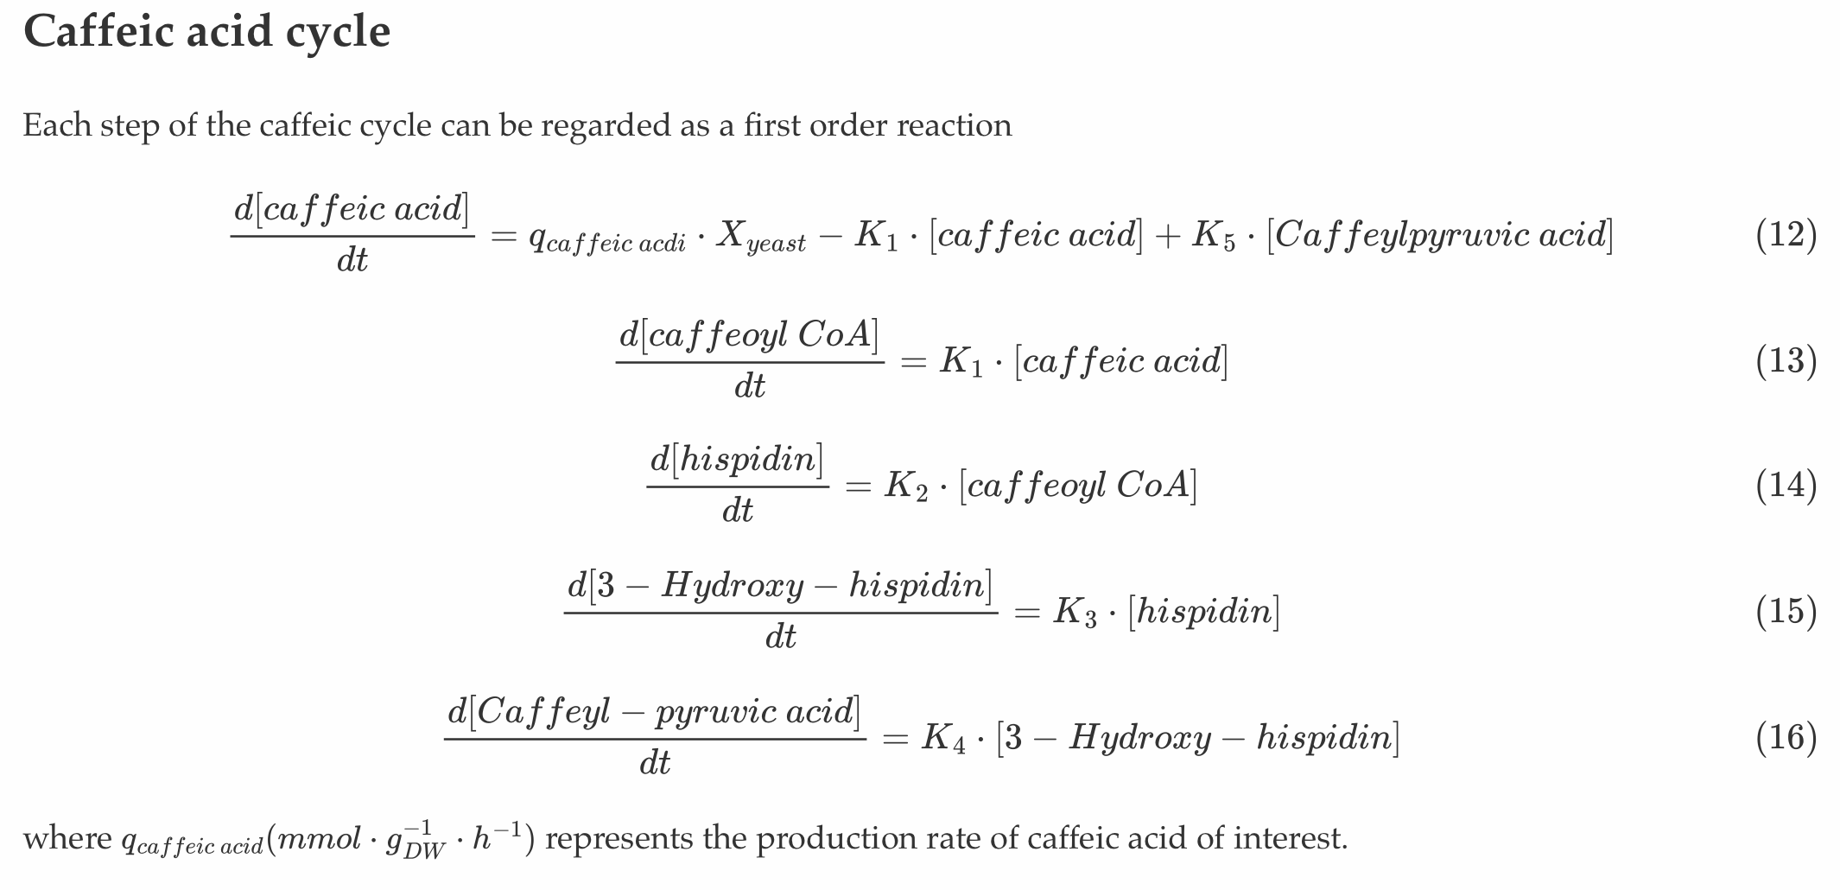
Dry Lab: A Dynamic Coculture Model

Slide 44
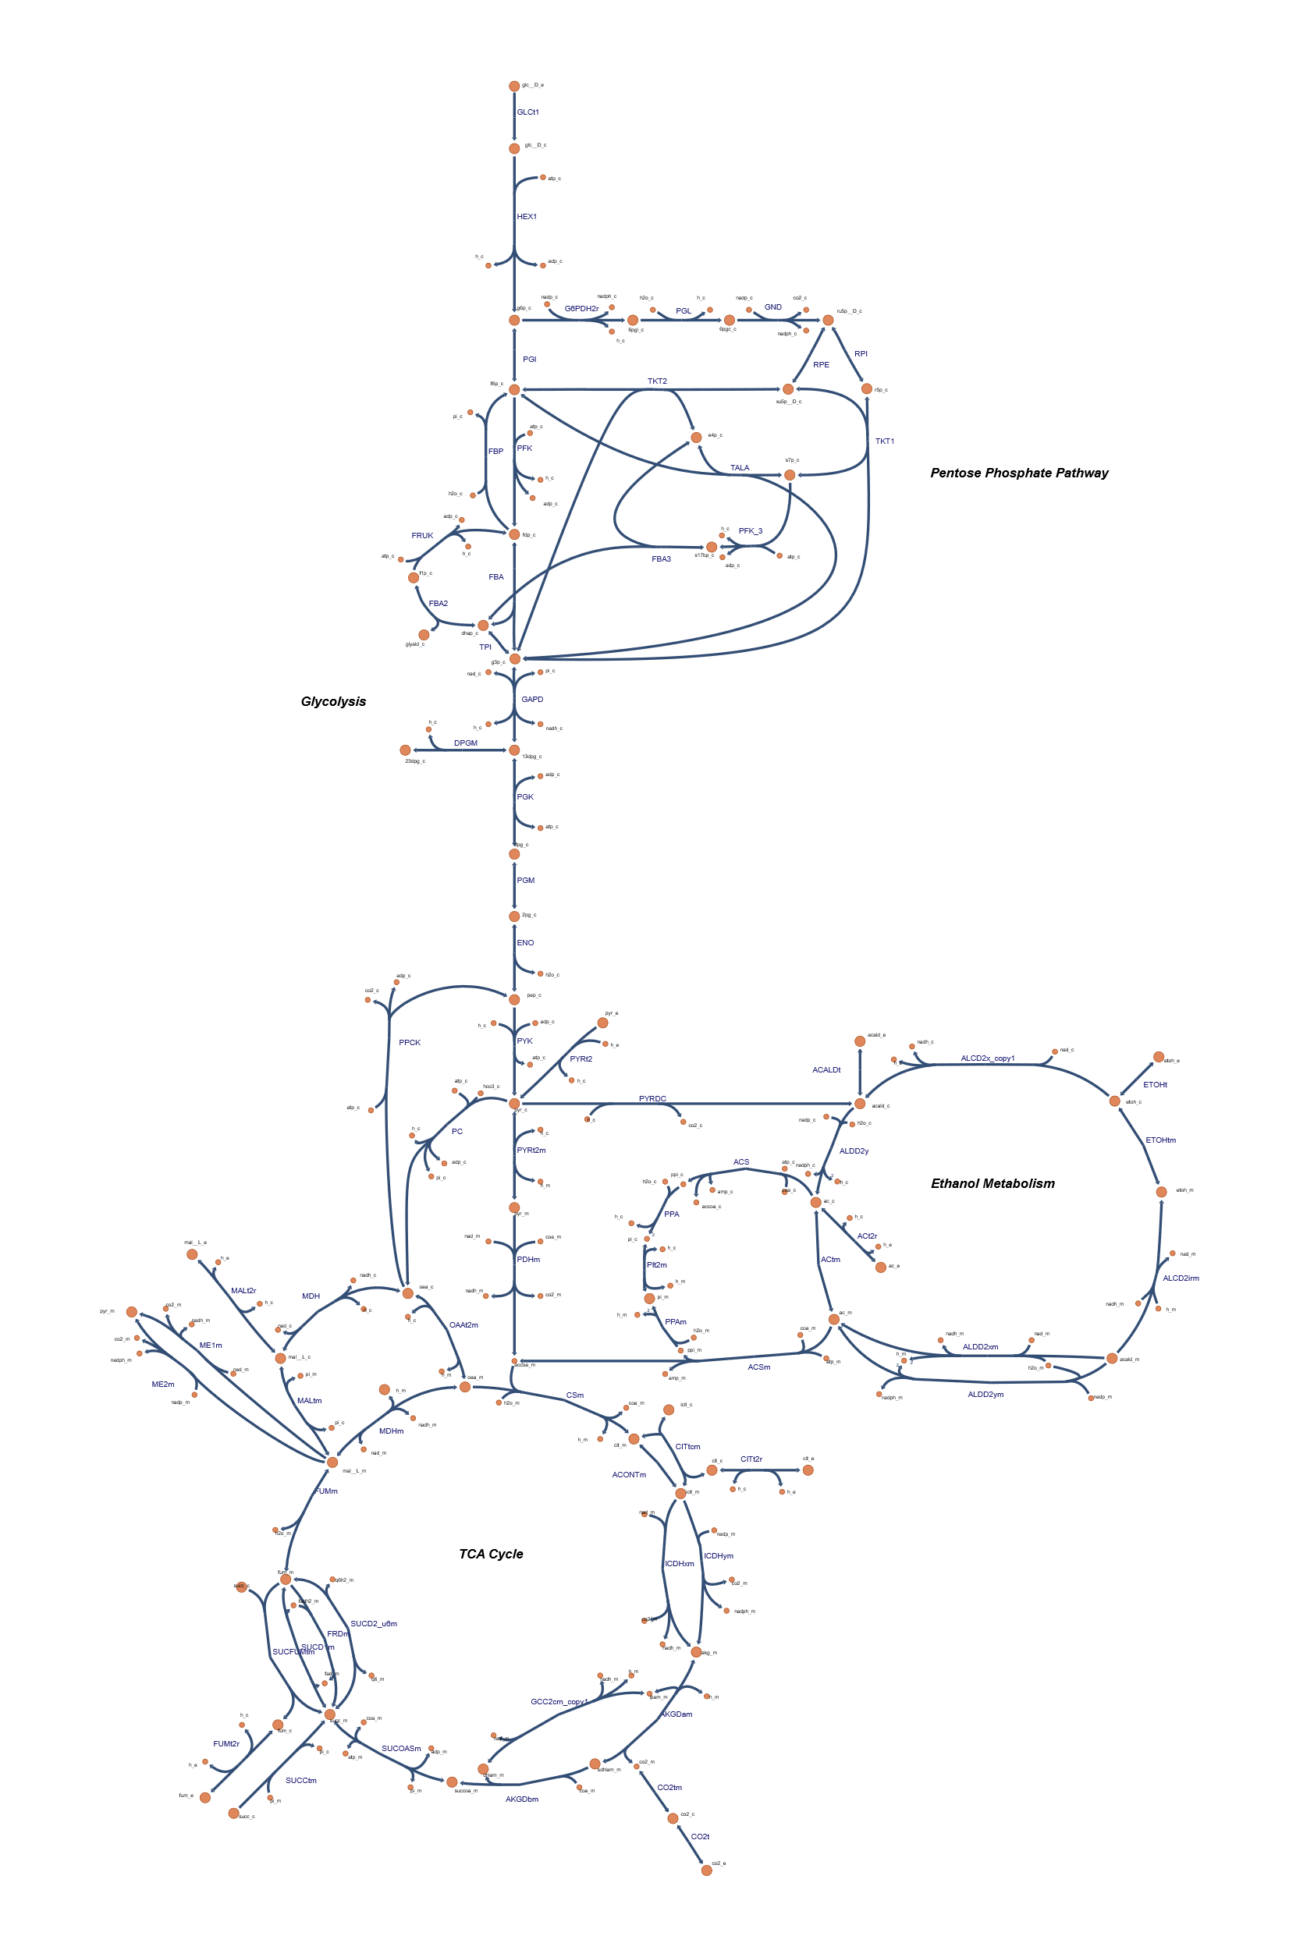
Dry Lab: A Dynamic Coculture Model
Genome Scale Models
Our model of S.cerevisiae is based on the GSM iMM904 developed by Monica L Mo et al. in 2009 [9].
iMM904 is a basic model in yeast, containing 1226 metabolites and 1577 reactions. And for the S.elongatus, we chose model iJB785 developed by Jared T Broddrick et al. in 2016 [10].
This model contains 768 metabolites and 849 reactions.We further added 6 metabolites and 16 reactions to complete the system.
Escher map of model iMM904. By BIGG.

Slide 45
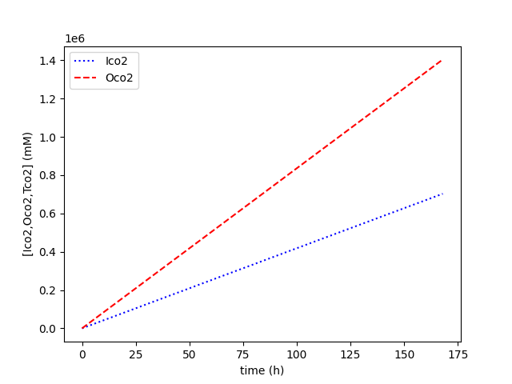
Dry Lab: A Dynamic Coculture Model
Results
Unfortunately, due to our poor knowledge on SBML and cobrapy package, it seems too difficult for us to rebuild our own model. But there does have something we can do.
Carbon accounting
Based on the similar module developed by Toulouse INSA-UPS.It is notable that they put this bio-manufacturing system under light all day-long while we utilize this system as street lighting, so the carbon intake should be half. We run the simulation and get the results as followed.
Carbon accounting results.

Slide 46
Dry Lab: A Dynamic Coculture Model
Further calculation and Learn
The result shows that the co-culture system can release the carbon burden to a certain extent. But completely carbon neutral can be achieved only if cyano get light all day.
To go further, we will compare CYSL with traditional LED light. Suppose the size of light is 0.3×0.3×0.1=0.009m³
It can be easily figured out that the carbon cost for CYSL in a day≈0.009× (0.2-0.1)×10⁶×0.044=39.6kg.
Suppose the average power of traditional street lighting is 150w for 10h, and one kilowatt hour require 1.5kg CO₂ . So the carbon cost of traditional street lighting in a day is 2.25kg.
Although at present CYSL seem to be too weak to substitute traditional street lighting, it is notable that when cyanophyta receive light all day long, the carbon release of CYSL is near zero. And our system itself is actually giving out light in dark! With more editing carried out in CYSL, we believe it holds great potential to achieve better carbon efficiency.

Slide 47
Human Practice
Overview
We aim to create something that is both environmental-friendly and multi-functional.
The bio-street lighting should not only be able to light up the night but also light up the people's mind of environmental conservation.
So the human practice were designed to better understand current situation of energy structure, bio-luminescence system, commercial potential of carbon-free light system and how to influence the next generation.

Slide 48
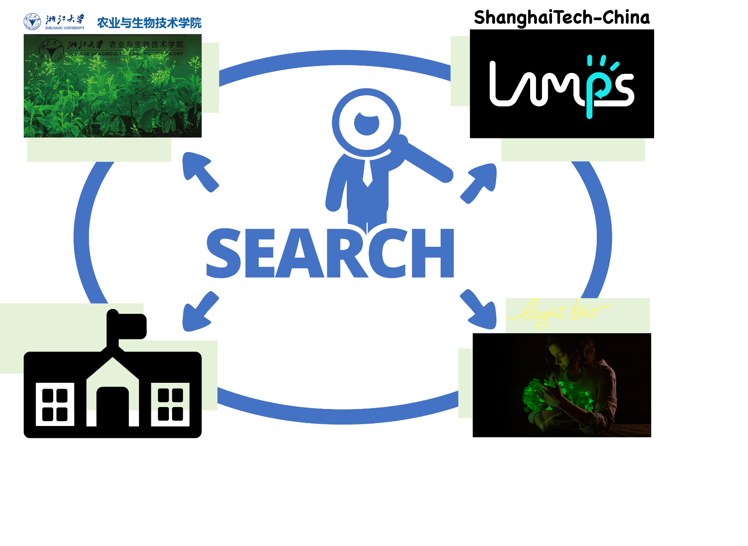
Human Practice: Integrated Human Practice
Overview
“If I have seen further it is by standing on ye shoulder of Giants.” ——Newton
As a young team eager to do something, we'll definitely go further with the aid of predecessor.
In the integrated human practice, we mainly focus on the communication with different research groups and relevant organizations
Representation of our integrated human practice

Slide 49
Human Practice: Integrated Human Practice
Government
It is estimated that the use of intelligent LED lighting products can save 80% of electricity in Beijing.
Promote 2 million (sets) of intelligent LED lighting products, which can save 200 million kilowatt-hours of electricity per year, save 220 million yuan of electricity, and reduce 170,000 tons of carbon dioxide [11].
What the Earth looks like at night on 2022 February 13. By NASA

Slide 50

Human Practice: Integrated Human Practice
Government
We planned to have a conversation with Beijing municipal ecology and environment bureau.
The conversation should be focus on present energy structure and street lighting situation of Beijing, how does the green light project move forward and what should be take care of from the perspective of policy makers.

Slide 51
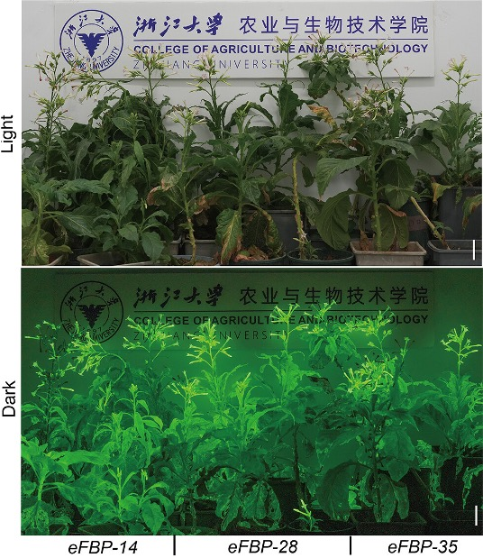
Human Practice: Integrated Human Practice
Du hao’s team
Du hao’s team from college of agriculture and biotechnology of Zhejiang university has been keen on the engineering of plants.
In 2023, they proposed a new strategy to transplant the caffeic acid cycle into plants and successfully improved the brightness of luminous plant [12].
Since they chose the same bio-luminescence system, we can learn from how they transplant the caffeic acid cycle and how they improved it.
Compared to our microbial carrier, they chose plants to load the bio-luminescence cycle. It should be interesting and meaningful to compare the two different choices and help us to further design our model.
The performance of eFBP bioluminescent plants in lighting up the room [12].

Slide 52
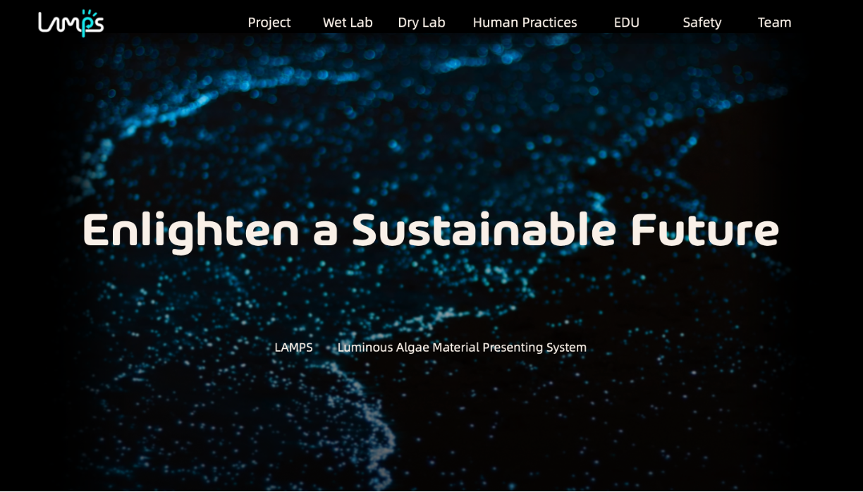
Human Practice: Integrated Human Practice
ShanghaiTech-China-2023
ShanghaiTech-China-2023 carried out a similar project of ours.
Instead of caffeic acid cycle, they select a bacterial-original luminescence system to create light.
And they choose to transfer the system directly into cyanophyta to create light.
It should be beneficial to have a communication with them.
Homepage of ShanghaiTech-China-2023‘s wiki.

Slide 53
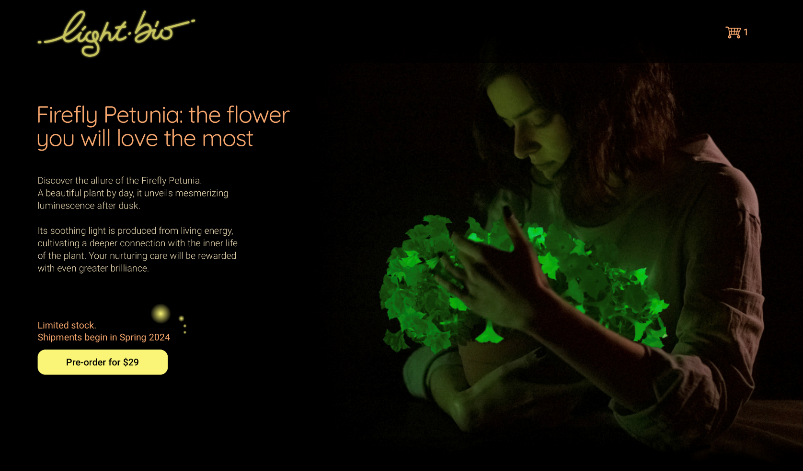
Human Practice: Integrated Human Practice
Light Bio
Light bio is a commercial company celling firefly petunia.
It's interesting to learn how they come up with the idea and how to make it profitable.
Selling a living plant is different from selling an iphone, especially for genetically engineered plants.
How to make the light sustainable is also a key question we care about.
Homepage of Light Bio

Slide 54
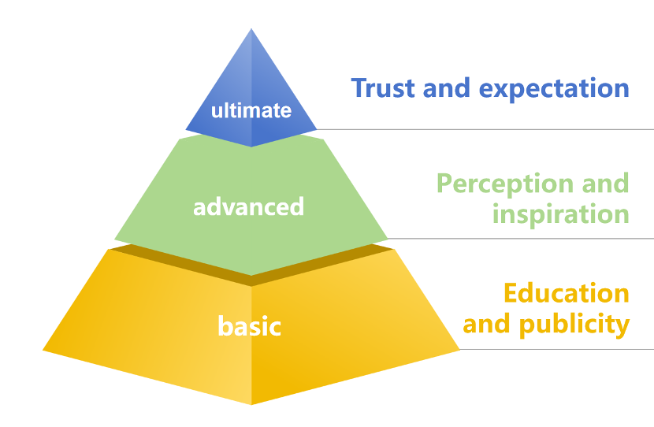
Human Practice: Education
Progressive goals during our education

Slide 55
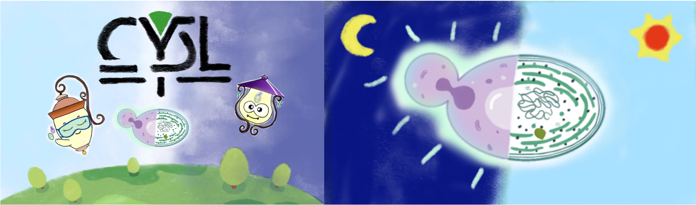
Human Practice: Education
Prepare tools needed for for education and communication
Examples of illustrations of our fairy tale book.
a poster to introduction to synthetic biology and our projects
fairy tale book, The Prince of Cyanobacteria and the Princess of Yeast Defeat the Carbon Dioxide Monster
a slide introducing basic knowledge for junior high school students.
Brochures corresponds to our project, emphasizing the environmental and energy value of the project

Slide 56
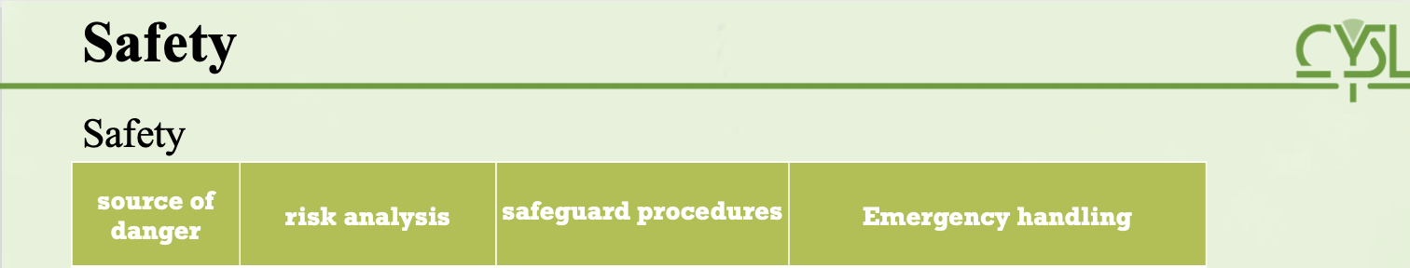
Safety
Safety
source of danger | risk analysis | safeguard procedures | Emergency handling
Super-clean bench | Ultraviolet radiation can harm glasses, causing severe damage such as retinal detachment or blindness. Tipping over the alcohol lamp may result in a fire within the area of the bench. During operation, the alcohol lamp may ignite items such as cotton swabs. | When using ultraviolet disinfection lamp, lower the glass shield; turn off the ultraviolet lamp before operation. The alcohol lamp ignites immediately upon use; ensure to extinguish the lamp when not in use. When using the alcohol lamp, keep other flammable items at a safe distance from the lamp | In case of a fire, immediately shut off the laminar flow hood's ventilation, then use a fire blanket or fire extinguisher to extinguish the fire.
S. elongatus UTEX 2973 CscB+/Saccharomyces cerevisiae W303^{clump} | Pouring into the sewer randomly may cause environmental issues. | Wear lab coats and gloves during operations, and pay attention to the collection, isolation, and deactivation of microorganisms and culture media. | Disinfect with alcohol and ensure proper packaging and disposal of waste.
IPTG | Harmful if swallowed. Harmful if in contact with skin. Harmful if inhaled. | Do not swallow. Wear lab coats and gloves to avoid skin contact. Prevent inhalation. | Inhalation: If inhaled, move the person to fresh air. Skin contact: Remove contaminated clothing, wash skin thoroughly with soap and water. If irritation occurs, seek medical attention. Eye contact: Separate eyelids, flush with flowing water or saline solution. Seek medical attention immediately. Ingestion: Rinse mouth, do not induce vomiting. Seek medical attention immediately.
­­­DMSO | Combustible when exposed to heat or flame. The vapour is heavier than air and may travel along the ground; distant ignition possible. DIMETHYL SULFOXIDE decomposes violently on contact with many acyl halides and related compounds. Slight eye irritation | Eye/face protection Wear safety spectacles. Skin protection Protective gloves. Protective clothing. Respiratory protection Use ventilation, local exhaust or breathing protection. Ensure adequate ventilation. Handle in accordance with good industrial hygiene and safety practice. Set up emergency exits and the risk-elimination area. | For small (incipient) fires, use media such as "alcohol" foam, dry chemical, or carbon dioxide. For large fires, apply water from as far as possible. Use very large quantities (flooding) of water applied as a mist or spray; solid streams of water may be ineffective. Cool all affected containers with flooding quantities of water. Description of necessary first-aid measures If inhaled Fresh air, rest. Following skin contact Remove contaminated clothes. Rinse and then wash skin with water and soap. Refer for medical attention . Following eye contact First rinse with plenty of water for several minutes (remove contact lenses if easily possible), then refer for medical attention. Following ingestion Do NOT induce vomiting. Refer for medical attention .
EtBr | Red-to-brown crystals Harmful if swallowed Fatal if inhaled Suspected of causing genetic defects Combustible. Gives off irritating or toxic fumes (or gases) in a fire. | Eye/face protection Wear safety goggles. Skin protection Protective gloves. Respiratory protection Use local exhaust. Use breathing protection. | If inhaled Fresh air, rest. Following skin contact Rinse and then wash skin with water and soap. Following eye contact Rinse with plenty of water for several minutes (remove contact lenses if easily possible). Following ingestion Rinse mouth. For fires, use water spray, powder, alcohol-resistant foam, carbon dioxide.
LiAc | Harmful if swallowed |  | Following ingestion Rinse mouth with water. Do not induce vomiting. Never give anything by mouth to an unconscious person. Call a doctor or Poison Control Center immediately.
EDTA | Causes serious eye irritation Combustible, but it does not easily ignite. Gives off irritating or toxic fumes (or gases) in a fire. Finely dispersed particles form explosive mixtures in air. | Wash thoroughly after handling. Wear protective gloves/protective clothing/eye protection/face protection/hearing protection/... | If inhaled Fresh air, rest. Following skin contact Rinse skin with plenty of water or shower. Following eye contact Rinse with plenty of water (remove contact lenses if easily possible). Following ingestion Rinse mouth. Give one or two glasses of water to drink. Use water spray, foam, carbon dioxide, powder.
PEG | Combustible. | NO open flames. Handling in a well-ventilated place. Use non-sparking tools. Prevent fire caused by electrostatic discharge steam. | Use dry chemical, carbon dioxide or alcohol-resistant foam.
nucleic acid dyes | Nucleic acid dyes are mutagenic and can intercalate into DNA, posing a risk if ingested, inhaled, or contacted with skin. | Personal Protective Equipment (PPE): Always wear appropriate PPE, including gloves, lab coat, and safety glasses to minimize skin contact and eye exposure. Ventilation: Use these dyes in a well-ventilated area or under a fume hood to avoid inhalation of any vapors or dust. Minimize Exposure: Use the minimum amount of dye necessary for your experiments to reduce the risk of exposure and environmental contamination. Safe Storage: Store dyes in a cool, dry, dark place to prevent degradation and accidental spills. Ensure containers are clearly labeled and securely closed. | Skin Contact: In case of skin contact, immediately wash the area with plenty of water and soap. Remove contaminated clothing. Eye Exposure: If the dye contacts the eyes, rinse immediately with plenty of water for at least 15 minutes and seek medical attention. Inhalation: Move the person to fresh air immediately if there are signs of respiratory discomfort. If symptoms persist, seek medical attention. Spills: In the event of a spill, wear PPE, avoid creating dust, and clean up the spill using appropriate absorbent materials. Dispose of the waste according to local regulations.
PEG 3350 | PEG 3350 can be irritating to eyes, skin, and respiratory system. | Personal Protective Equipment (PPE): Wear gloves, protective clothing, and eye protection to avoid skin and eye contact. Handling: Handle PEG 3350 in a manner that minimizes dust generation and accumulation. Use with adequate ventilation to avoid inhalation. Storage: Store in a cool, dry place in tightly closed containers, away from incompatible materials. | Skin Contact: Wash the skin thoroughly with soap and water after contact. Remove contaminated clothing. Eye Contact: Rinse cautiously with water for several minutes. Remove contact lenses if present and easy to do. Continue rinsing and seek medical advice if irritation persists. Inhalation: If inhaled, move the person to fresh air. If not breathing, give artificial respiration. If breathing is difficult, give oxygen and seek medical advice. Spills: Avoid raising dust. Ventilate the area. Clean up spills immediately, observing precautions in the Protective Equipment section. Use a vacuum or wet method to reduce dust.

Slide 57
source of danger | risk analysis | safeguard procedures | Emergency handling
Super-clean bench | Ultraviolet radiation can harm glasses, causing severe damage such as retinal detachment or blindness. Tipping over the alcohol lamp may result in a fire within the area of the bench. During operation, the alcohol lamp may ignite items such as cotton swabs. | When using ultraviolet disinfection lamp, lower the glass shield; turn off the ultraviolet lamp before operation. The alcohol lamp ignites immediately upon use; ensure to extinguish the lamp when not in use. When using the alcohol lamp, keep other flammable items at a safe distance from the lamp | In case of a fire, immediately shut off the laminar flow hood's ventilation, then use a fire blanket or fire extinguisher to extinguish the fire.
S. elongatus UTEX 2973 CscB+/Saccharomyces cerevisiae W303^{clump} | Pouring into the sewer randomly may cause environmental issues. | Wear lab coats and gloves during operations, and pay attention to the collection, isolation, and deactivation of microorganisms and culture media. | Disinfect with alcohol and ensure proper packaging and disposal of waste.
IPTG | Harmful if swallowed. Harmful if in contact with skin. Harmful if inhaled. | Do not swallow. Wear lab coats and gloves to avoid skin contact. Prevent inhalation. | Inhalation: If inhaled, move the person to fresh air. Skin contact: Remove contaminated clothing, wash skin thoroughly with soap and water. If irritation occurs, seek medical attention. Eye contact: Separate eyelids, flush with flowing water or saline solution. Seek medical attention immediately. Ingestion: Rinse mouth, do not induce vomiting. Seek medical attention immediately.
­­­DMSO | Combustible when exposed to heat or flame. The vapour is heavier than air and may travel along the ground; distant ignition possible. DIMETHYL SULFOXIDE decomposes violently on contact with many acyl halides and related compounds. Slight eye irritation | Eye/face protection Wear safety spectacles. Skin protection Protective gloves. Protective clothing. Respiratory protection Use ventilation, local exhaust or breathing protection. Ensure adequate ventilation. Handle in accordance with good industrial hygiene and safety practice. Set up emergency exits and the risk-elimination area. | For small (incipient) fires, use media such as "alcohol" foam, dry chemical, or carbon dioxide. For large fires, apply water from as far as possible. Use very large quantities (flooding) of water applied as a mist or spray; solid streams of water may be ineffective. Cool all affected containers with flooding quantities of water. Description of necessary first-aid measures If inhaled Fresh air, rest. Following skin contact Remove contaminated clothes. Rinse and then wash skin with water and soap. Refer for medical attention . Following eye contact First rinse with plenty of water for several minutes (remove contact lenses if easily possible), then refer for medical attention. Following ingestion Do NOT induce vomiting. Refer for medical attention .
EtBr | Red-to-brown crystals Harmful if swallowed Fatal if inhaled Suspected of causing genetic defects Combustible. Gives off irritating or toxic fumes (or gases) in a fire. | Eye/face protection Wear safety goggles. Skin protection Protective gloves. Respiratory protection Use local exhaust. Use breathing protection. | If inhaled Fresh air, rest. Following skin contact Rinse and then wash skin with water and soap. Following eye contact Rinse with plenty of water for several minutes (remove contact lenses if easily possible). Following ingestion Rinse mouth. For fires, use water spray, powder, alcohol-resistant foam, carbon dioxide.
LiAc | Harmful if swallowed |  | Following ingestion Rinse mouth with water. Do not induce vomiting. Never give anything by mouth to an unconscious person. Call a doctor or Poison Control Center immediately.
EDTA | Causes serious eye irritation Combustible, but it does not easily ignite. Gives off irritating or toxic fumes (or gases) in a fire. Finely dispersed particles form explosive mixtures in air. | Wash thoroughly after handling. Wear protective gloves/protective clothing/eye protection/face protection/hearing protection/... | If inhaled Fresh air, rest. Following skin contact Rinse skin with plenty of water or shower. Following eye contact Rinse with plenty of water (remove contact lenses if easily possible). Following ingestion Rinse mouth. Give one or two glasses of water to drink. Use water spray, foam, carbon dioxide, powder.
PEG | Combustible. | NO open flames. Handling in a well-ventilated place. Use non-sparking tools. Prevent fire caused by electrostatic discharge steam. | Use dry chemical, carbon dioxide or alcohol-resistant foam.
nucleic acid dyes | Nucleic acid dyes are mutagenic and can intercalate into DNA, posing a risk if ingested, inhaled, or contacted with skin. | Personal Protective Equipment (PPE): Always wear appropriate PPE, including gloves, lab coat, and safety glasses to minimize skin contact and eye exposure. Ventilation: Use these dyes in a well-ventilated area or under a fume hood to avoid inhalation of any vapors or dust. Minimize Exposure: Use the minimum amount of dye necessary for your experiments to reduce the risk of exposure and environmental contamination. Safe Storage: Store dyes in a cool, dry, dark place to prevent degradation and accidental spills. Ensure containers are clearly labeled and securely closed. | Skin Contact: In case of skin contact, immediately wash the area with plenty of water and soap. Remove contaminated clothing. Eye Exposure: If the dye contacts the eyes, rinse immediately with plenty of water for at least 15 minutes and seek medical attention. Inhalation: Move the person to fresh air immediately if there are signs of respiratory discomfort. If symptoms persist, seek medical attention. Spills: In the event of a spill, wear PPE, avoid creating dust, and clean up the spill using appropriate absorbent materials. Dispose of the waste according to local regulations.
PEG 3350 | PEG 3350 can be irritating to eyes, skin, and respiratory system. | Personal Protective Equipment (PPE): Wear gloves, protective clothing, and eye protection to avoid skin and eye contact. Handling: Handle PEG 3350 in a manner that minimizes dust generation and accumulation. Use with adequate ventilation to avoid inhalation. Storage: Store in a cool, dry place in tightly closed containers, away from incompatible materials. | Skin Contact: Wash the skin thoroughly with soap and water after contact. Remove contaminated clothing. Eye Contact: Rinse cautiously with water for several minutes. Remove contact lenses if present and easy to do. Continue rinsing and seek medical advice if irritation persists. Inhalation: If inhaled, move the person to fresh air. If not breathing, give artificial respiration. If breathing is difficult, give oxygen and seek medical advice. Spills: Avoid raising dust. Ventilate the area. Clean up spills immediately, observing precautions in the Protective Equipment section. Use a vacuum or wet method to reduce dust.
Safety
Safety

Slide 58
source of danger | risk analysis | safeguard procedures | Emergency handling
Super-clean bench | Ultraviolet radiation can harm glasses, causing severe damage such as retinal detachment or blindness. Tipping over the alcohol lamp may result in a fire within the area of the bench. During operation, the alcohol lamp may ignite items such as cotton swabs. | When using ultraviolet disinfection lamp, lower the glass shield; turn off the ultraviolet lamp before operation. The alcohol lamp ignites immediately upon use; ensure to extinguish the lamp when not in use. When using the alcohol lamp, keep other flammable items at a safe distance from the lamp | In case of a fire, immediately shut off the laminar flow hood's ventilation, then use a fire blanket or fire extinguisher to extinguish the fire.
S. elongatus UTEX 2973 CscB+/Saccharomyces cerevisiae W303^{clump} | Pouring into the sewer randomly may cause environmental issues. | Wear lab coats and gloves during operations, and pay attention to the collection, isolation, and deactivation of microorganisms and culture media. | Disinfect with alcohol and ensure proper packaging and disposal of waste.
IPTG | Harmful if swallowed. Harmful if in contact with skin. Harmful if inhaled. | Do not swallow. Wear lab coats and gloves to avoid skin contact. Prevent inhalation. | Inhalation: If inhaled, move the person to fresh air. Skin contact: Remove contaminated clothing, wash skin thoroughly with soap and water. If irritation occurs, seek medical attention. Eye contact: Separate eyelids, flush with flowing water or saline solution. Seek medical attention immediately. Ingestion: Rinse mouth, do not induce vomiting. Seek medical attention immediately.
­­­DMSO | Combustible when exposed to heat or flame. The vapour is heavier than air and may travel along the ground; distant ignition possible. DIMETHYL SULFOXIDE decomposes violently on contact with many acyl halides and related compounds. Slight eye irritation | Eye/face protection Wear safety spectacles. Skin protection Protective gloves. Protective clothing. Respiratory protection Use ventilation, local exhaust or breathing protection. Ensure adequate ventilation. Handle in accordance with good industrial hygiene and safety practice. Set up emergency exits and the risk-elimination area. | For small (incipient) fires, use media such as "alcohol" foam, dry chemical, or carbon dioxide. For large fires, apply water from as far as possible. Use very large quantities (flooding) of water applied as a mist or spray; solid streams of water may be ineffective. Cool all affected containers with flooding quantities of water. Description of necessary first-aid measures If inhaled Fresh air, rest. Following skin contact Remove contaminated clothes. Rinse and then wash skin with water and soap. Refer for medical attention . Following eye contact First rinse with plenty of water for several minutes (remove contact lenses if easily possible), then refer for medical attention. Following ingestion Do NOT induce vomiting. Refer for medical attention .
EtBr | Red-to-brown crystals Harmful if swallowed Fatal if inhaled Suspected of causing genetic defects Combustible. Gives off irritating or toxic fumes (or gases) in a fire. | Eye/face protection Wear safety goggles. Skin protection Protective gloves. Respiratory protection Use local exhaust. Use breathing protection. | If inhaled Fresh air, rest. Following skin contact Rinse and then wash skin with water and soap. Following eye contact Rinse with plenty of water for several minutes (remove contact lenses if easily possible). Following ingestion Rinse mouth. For fires, use water spray, powder, alcohol-resistant foam, carbon dioxide.
LiAc | Harmful if swallowed |  | Following ingestion Rinse mouth with water. Do not induce vomiting. Never give anything by mouth to an unconscious person. Call a doctor or Poison Control Center immediately.
EDTA | Causes serious eye irritation Combustible, but it does not easily ignite. Gives off irritating or toxic fumes (or gases) in a fire. Finely dispersed particles form explosive mixtures in air. | Wash thoroughly after handling. Wear protective gloves/protective clothing/eye protection/face protection/hearing protection/... | If inhaled Fresh air, rest. Following skin contact Rinse skin with plenty of water or shower. Following eye contact Rinse with plenty of water (remove contact lenses if easily possible). Following ingestion Rinse mouth. Give one or two glasses of water to drink. Use water spray, foam, carbon dioxide, powder.
PEG | Combustible. | NO open flames. Handling in a well-ventilated place. Use non-sparking tools. Prevent fire caused by electrostatic discharge steam. | Use dry chemical, carbon dioxide or alcohol-resistant foam.
nucleic acid dyes | Nucleic acid dyes are mutagenic and can intercalate into DNA, posing a risk if ingested, inhaled, or contacted with skin. | Personal Protective Equipment (PPE): Always wear appropriate PPE, including gloves, lab coat, and safety glasses to minimize skin contact and eye exposure. Ventilation: Use these dyes in a well-ventilated area or under a fume hood to avoid inhalation of any vapors or dust. Minimize Exposure: Use the minimum amount of dye necessary for your experiments to reduce the risk of exposure and environmental contamination. Safe Storage: Store dyes in a cool, dry, dark place to prevent degradation and accidental spills. Ensure containers are clearly labeled and securely closed. | Skin Contact: In case of skin contact, immediately wash the area with plenty of water and soap. Remove contaminated clothing. Eye Exposure: If the dye contacts the eyes, rinse immediately with plenty of water for at least 15 minutes and seek medical attention. Inhalation: Move the person to fresh air immediately if there are signs of respiratory discomfort. If symptoms persist, seek medical attention. Spills: In the event of a spill, wear PPE, avoid creating dust, and clean up the spill using appropriate absorbent materials. Dispose of the waste according to local regulations.
PEG 3350 | PEG 3350 can be irritating to eyes, skin, and respiratory system. | Personal Protective Equipment (PPE): Wear gloves, protective clothing, and eye protection to avoid skin and eye contact. Handling: Handle PEG 3350 in a manner that minimizes dust generation and accumulation. Use with adequate ventilation to avoid inhalation. Storage: Store in a cool, dry place in tightly closed containers, away from incompatible materials. | Skin Contact: Wash the skin thoroughly with soap and water after contact. Remove contaminated clothing. Eye Contact: Rinse cautiously with water for several minutes. Remove contact lenses if present and easy to do. Continue rinsing and seek medical advice if irritation persists. Inhalation: If inhaled, move the person to fresh air. If not breathing, give artificial respiration. If breathing is difficult, give oxygen and seek medical advice. Spills: Avoid raising dust. Ventilate the area. Clean up spills immediately, observing precautions in the Protective Equipment section. Use a vacuum or wet method to reduce dust.
Safety
Safety

Slide 59
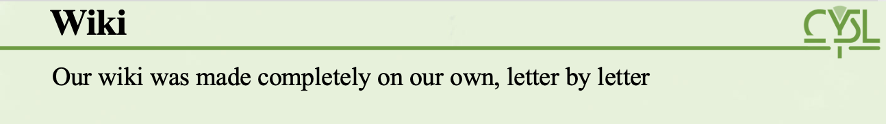
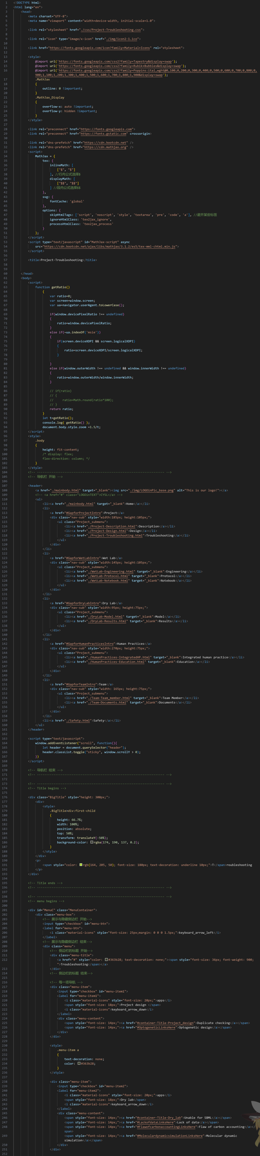


Wiki
Our wiki was made completely on our own, letter by letter

Slide 60
Wiki
Our wiki was made completely on our own, letter by letter

Slide 61
Wiki
Our wiki was made completely on our own, letter by letter

Slide 62
Wiki
We believe that a single slide can not give full expression to our design. Let’s get into it to see our
Wiki

Slide 63
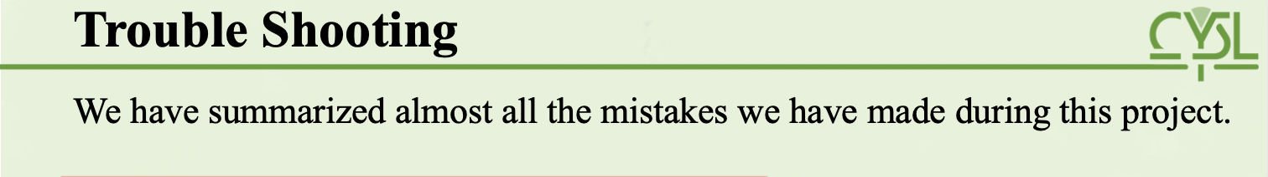






Trouble Shooting
We have summarized almost all the mistakes we have made during this project.
Learn more on our wiki!

Slide 64
Trouble Shooting
We have summarized almost all the mistakes we have made during this project.
Learn more on our wiki!

Slide 65
Trouble Shooting
We have summarized almost all the mistakes we have made during this project.
Learn more on our wiki!

Slide 66
Trouble Shooting
We have summarized almost all the mistakes we have made during this project.
Learn more on our wiki!

Slide 67
Trouble Shooting
We have summarized almost all the mistakes we have made during this project.
Learn more on our wiki!

Slide 68
Trouble Shooting
We have summarized almost all the mistakes we have made during this project.
Learn more on our wiki!

Slide 69
Trouble Shooting
We have summarized almost all the mistakes we have made during this project.
Learn more on our wiki!

Slide 70
Reference
[1] J. Yu, M. Liberton, P.F. Cliften, R.D. Head, J.M. Jacobs, R.D. Smith, D.W. Koppenaal, J.J. Brand, H.B. Pakrasi, Synechococcus elongatus UTEX 2973, a fast growing cyanobacterial chassis for biosynthesis using light and CO(2), Sci Rep, 5 (2015) 8132.
[2] J. Ungerer, K.E. Wendt, J.I. Hendry, C.D. Maranas, H.B. Pakrasi, Comparative genomics reveals the molecular determinants of rapid growth of the cyanobacterium Synechococcus elongatus UTEX 2973, Proc Natl Acad Sci U S A, 115 (2018) E11761-E11770.\
[3] S.G. Hays, L.L.W. Yan, P.A. Silver, D.C. Ducat, Synthetic photosynthetic consortia define interactions leading to robustness and photoproduction, J Biol Eng, 11 (2017) 4.
[4] T. Li, C.T. Li, K. Butler, S.G. Hays, M.T. Guarnieri, G.A. Oyler, M.J. Betenbaugh, Mimicking lichens: incorporation of yeast strains together with sucrose-secreting cyanobacteria improves survival, growth, ROS removal, and lipid production in a stable mutualistic co-culture production platform, Biotechnol Biofuels, 10 (2017) 55.
[5] A.A. Kotlobay, K.S. Sarkisyan, Y.A. Mokrushina, M. Marcet-Houben, E.O. Serebrovskaya, N.M. Markina, L. Gonzalez Somermeyer, A.Y. Gorokhovatsky, A. Vvedensky, K.V. Purtov, V.N. Petushkov, N.S. Rodionova, T.V. Chepurnyh, L.I. Fakhranurova, E.B. Guglya, R. Ziganshin, A.S. Tsarkova, Z.M. Kaskova, V. Shender, M. Abakumov, T.O. Abakumova, I.S. Povolotskaya, F.M. Eroshkin, A.G. Zaraisky, A.S. Mishin, S.V. Dolgov, T.Y. Mitiouchkina, E.P. Kopantzev, H.E. Waldenmaier, A.G. Oliveira, Y. Oba, E. Barsova, E.A. Bogdanova, T. Gabaldon, C.V. Stevani, S. Lukyanov, I.V. Smirnov, J.I. Gitelson, F.A. Kondrashov, I.V. Yampolsky, Genetically encodable bioluminescent system from fungi, Proc Natl Acad Sci U S A, 115 (2018) 12728-12732.

Slide 71
Reference
[6] Y. Li, J. Mao, Q. Liu, X. Song, Y. Wu, M. Cai, H. Xu, M. Qiao, De Novo Biosynthesis of Caffeic Acid from Glucose by Engineered Saccharomyces cerevisiae, ACS Synth Biol, 9 (2020) 756-765.
[7] S.Y. Roth, Chromatin-mediated transcriptional repression in yeast, Curr Opin Genet Dev, 5 (1995) 168-173.
[8] M. Hirst, C. Ho, L. Sabourin, M. Rudnicki, L. Penn, I. Sadowski, A two-hybrid system for transactivator bait proteins, Proceedings of the National Academy of Sciences, 98 (2001) 8726-8731.
[9] M.L. Mo, B.Ø. Palsson, M.J. Herrgård, Connecting extracellular metabolomic measurements to intracellular flux states in yeast, BMC systems biology, 3 (2009) 1-17.
[10] J.T. Broddrick, B.E. Rubin, D.G. Welkie, N. Du, N. Mih, S. Diamond, J.J. Lee, S.S. Golden, B.O. Palsson, Unique attributes of cyanobacterial metabolism revealed by improved genome-scale metabolic modeling and essential gene analysis, Proceedings of the National Academy of Sciences, 113 (2016) E8344-E8353.
[11]京发改[2016]1586号《北京市“十三五”时期绿色照明工程实施方案》
[12] Zheng, P., Ge, J., Ji, J., Zhong, J., Chen, H., Luo, D., Li, W., Bi, B., Ma, Y., Tong, W., Han, L., Ma, S., Zhang, Y., Wu, J., Zhao, Y., Pan, R., Fan, P., Lu, M. and Du, H. (2023), Metabolic engineering and mechanical investigation of enhanced plant autoluminescence. Plant Biotechnol. J, 21: 1671-1681. doi: 10.1111/pbi.14068
[13] S. Petrezselyova, J. Zahradka, H. Sychrova, Saccharomyces cerevisiae BY4741 and W303-1A laboratory strains differ in salt tolerance, Fungal Biology, 114 (2010) 144-150.

Slide 72


About us
 | Weijie Li | Chengxue Zhang | Jiantin Gong | Jiayi Yang | Zirui Liu | Weimin Lu
Wet Lab
Dry Lab
Art Design
Human Practice
Wiki
Learn more on our wiki!

